Slide 1
Data Modeling
Jason

Slide 2


























































Eventhouse (incl. KQL Databases)
MCP Server
Eventhouse
REST API
KQL Database (1… n)
KQL Queryset
Update Policies
Ingestion
Real-Time Dashboard
Native Table
Native Table
Materialized View
Serilog
Nlog
SDKs & Logging Frameworks
Semantic Model
Power BI Report
Accelerated Shortcut
Python + Spark Notebook
External Table
OneLake Delta Tables
KQL Database (1… n)
Data Agent
Shortcut
Copilot
Azure Data Explorer
or Eventhouse
Followed Table
Eventstream
Ingestion
Analytics
Digital Twin Builder
Dashboards
Rules
Actions
AI
Real-Time Hub
OneLake
Connectors

Slide 3
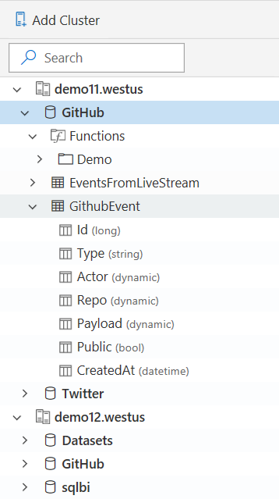
Schema
Schema is
Relational, Lightweight, Dynamic
Databases
Authorization boundary
Transaction boundary
But not query boundary!
Supporting cross-database and cross-cluster queries
Tables
Rectangular
Columns
Supported types: Boolean, integer, real, date/time, timespan, string, dynamic (JSON)
Stored functions

Slide 4
Data Storage – Column Store
Sharded columnar store
Data is organized in immutable Extents
All columns are compressed
All columns are indexed
Indexes can be trivial (e.g., a date/time index is just min/max values)
Indexes can be very complex (e.g., a full substring index for string columns allowing complex and efficient match operations)

Slide 5



Data tiering
Basics
Eventhouse is a great tool for storing large volumes of data due to high compression ratios. However, storing all the data on fast media can be prohibitively expensive.
Eventhouse offers tiering mechanism with full transparency to the user – i.e., same query, data in different places.
Data can sit in RAM of compute nodes, local SSDs, or cold storage (Azure Blob).
The “where” is defined by caching policies. Important to remember – all data remains query-able.
Eventhouse Cluster
Outside of Cluster
Data Management
Engine
Remote Storage
Hot (RAM)
Cold (Blob)
Connections
Management
Engine nodes
Ingestion
Warm (SSD)
Batching
Local SSDs
OneLake

Slide 6
Caching Policy
Usage scenarios
Users are typically interested in recent data – last hour or day - as they, for example, perform troubleshooting. However, data may be preserved for years for business/regulatory requirements.
Caching policies dramatically lower cost by moving older than x-since ingestion to cold storage.
Users can define additional time windows of hot data to aid with analysis.
Queries can be scoped to target only hot data.
KQL Command
1
2
3
4
5
6
7
set query_datascope="hotcache"; MyTable | limit 10
.alter cluster policy caching hot = 30d
.alter cluster policy caching
hot = 30d,
hot_window = datetime(2021-01-01) .. datetime(2021-02-01)
Notes:
Define hot-cache windows
This command sets the caching policy to include the last 30 days and additional data from January and April 2021.

Slide 7
Retention Policy
Basics
Sometimes there is no need to keep old data.
Provides a way to automatically delete data after x-since ingestion.
The data is not deleted immediately but at some later point depending on the free resources in the cluster.
Rows beyond retention policy are not returned in queries.
Usage scenarios
Often combined with caching policies
RAM/SSDs -> Cold Storage -> Delete
Recoverability=enabled allows to un-delete data for 14 days.
Caching policy
Retention policy
Kusto
1
.alter-merge table MyTable policy retention softdelete = 365d recoverability = enabled
Notes:
Ref: https://docs.microsoft.com/azure/data-explorer/kusto/management/retentionpolicy

Slide 8
Data management Service & Ingestion
Data Formats:
CSV, TSV, SOHSV, SCSV, JSON, AVRO, PARQUET, ORC, TXT
Parsing, transposing, optional sorting, indexing, and compression
Ingestion rate - ~150-200MB/s per node (CSV)
Data management (DM) component
The ingestion service
Used to “adapt” any data source to target table format
Eventstream, EventHub, IoT Hub, EventGrid, …
Ingestions are batched by size and/or time
Integration with Row-Store
Triggers periodic data management tasks (retention, merge extents commands, etc.)

Slide 9
Engine Service
Single node type
All nodes are symmetrical
Any node can take over when a node is down
A single node is assigned to be the Admin node per database
Manages the database metadata (all metadata writes)
Creates the query plan based on the metadata (*usually)
Query plan is distributed to all nodes
All nodes participate in query execution – Tail nodes
Extents are assigned to nodes using consistent hashing
Scale in/out reshuffles extents between nodes
Shuffling is minimized

Slide 10
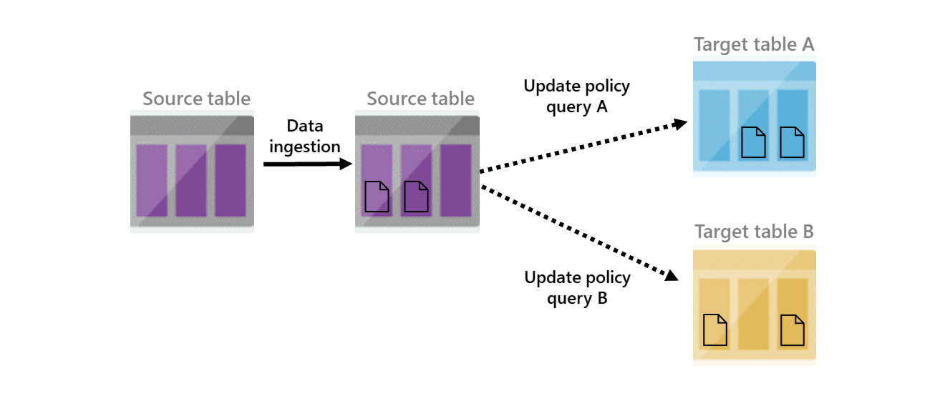
Update policies
Basics
Think of it as “lightweight ELT”
Attached to target table, execute function on new ingestion to source table
A table can have multiple update policies associated with it and policies can be chained.
Beware resource usage – test your code well.
Usage scenarios
Splitting data to multiple tables – e.g., receiving JSON events with different schemas
Filtering data – e.g., some data is not of interest, but upstream filtering is difficult
Data transformation – e.g., format changes, exploding JSON objects or arrays
Data ingestion
Update policy
query A
Update policy
query B
Notes:
Ref: https://docs.microsoft.com/azure/data-explorer/kusto/management/updatepolicy
PM Blog: https://y0nil.github.io/kusto.blog/blog-posts/update-policies.html

Slide 11
Usage Tips
If update policies are used to perform data transformations and original data does not need to be preserved, set soft delete to 0sec and the update policy to be transactional.
Example:
KQL Command
1
2
3
4
5
6
7
8
9
10
.alter-merge table SourceTable policy retention softdelete = 0sec recoverability = disabled
.create function TransformData() {
SourceTable | extend Counter = Counter * 2 //your business logic
}
.alter table TargetTable policy update
@'[{ "IsEnabled": true, "Source": "SourceTable", "Query": "TransformData()", "IsTransactional": true, "PropagateIngestionProperties": true}]'
Notes:
In production systems, set IsTransactional:true to ensure that the target table doesn't lose data in transient failures.
The update policy object
IsEnabled: States if update policy is true - enabled, or false - disabled
Source: Name of the table that triggers invocation of the update policy
Query: A query used to produce data for the update
IsTransactional: States if the update policy is transactional or not, default is false). If transactional and the update policy fails, the source table is not updated.
PropagateIngestion: States if properties specified during ingestion to the source table, such as extent tags and creation time, apply to the target table.

Slide 12
Considerations
Performance: Since update policies execute at ingestion time, they directly impact ingestion throughput. Complex policies (e.g., joins, regex parsing) may throttle ingestion if not tuned.
Query behavior: Policies must be ingestion-safe. That means they cannot use operators like join kind=inner on large tables without hint.strategy=broadcast, or call user-defined functions with unbounded logic.
Transformation Function: Must take no parameters and be deterministic. Think of it as a logical view over newly ingested data.
Error handling: If the update policy query fails, ingestion into the source table succeeds, but the target table is not updated. Failures are logged and can be monitored using .show ingestion failures.
Debugging: Use .show ingestion failures or temporarily disable the policy and run the transformation logic manually to troubleshoot.
Keep update policies idempotent and stateless — they should only process new ingested records, using ingestion-time context if needed.

Slide 13
Materialized Views
Expose an aggregation query over a source table, or over another materialized view.
Always return an up-to-date result of the aggregation query (always fresh).
Are more performant than running the aggregation directly over the source table.
Example:
Kusto
1
2
3
4
5
.create materialized-view with (backfill=true, autoUpdateSchema=true ) ArgMax on table T
{
T | summarize arg_max(Timestamp, *) by User
}
Note: Materialized views have some limitations, and don't work well for all scenarios. Review the performance considerations before working with the feature.
Notes:
https://docs.microsoft.com/azure/data-explorer/kusto/management/materialized-views/materialized-view-overview
https://docs.microsoft.com/azure/data-explorer/kusto/management/materialized-views/materialized-view-create#properties

Slide 14
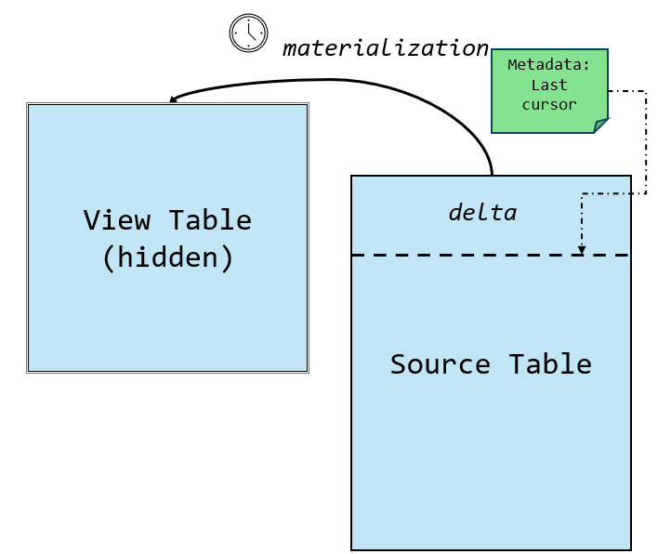
Internal Architecture
View table
Delta (Source Tail)
The hidden storage table containing the materialized extents
Newly ingested records not yet materialized
Metadata:
Last cursor
materialization
The cursor tracks how far materialization has progressed in the source table. During materialization:
Source table
View table (hidden)
delta
1
New data is read based on the cursor position
2
Overlapping data is soft-deleted
3
A single commit replaces the materialized extents
4
The cursor is advanced accordingly

Slide 15
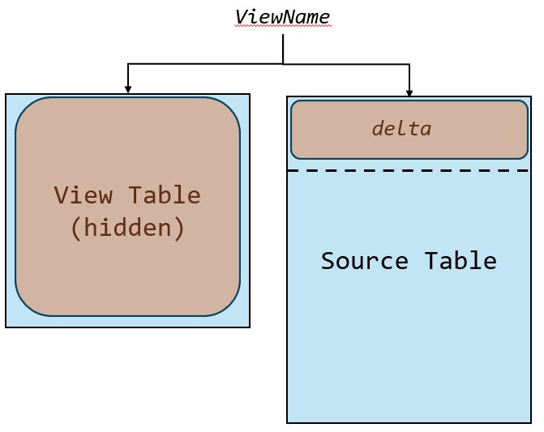
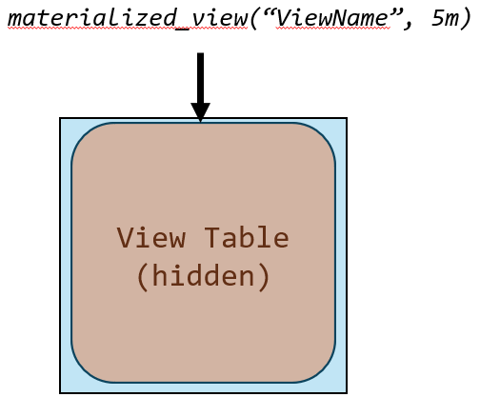
Query Execution Logic
view name
Query Planner Behavior
Aggregates the delta (non-materialized records)
Joins it with the materialized part
Applies rewrite rules and filter pushdown to optimize execution​
View table (hidden)
Source table
delta
Use materialized_view(“Viewname”, max_age) to explicitly reference materialized part
materialized_view (“ViewName”, 5m)
View table (hidden)

Slide 16
Manual Data Model Orchestration
Execute a query or a control command and ingest the results of the query into a table.
Command | If table exists | If table doesn’t exist
.set | Command fails | Creates table and ingests data
.append | Data is appended to the table | Command fails
.set-or-append | Data is appended to the table | Creates table and ingests data
.set-or-replace | Data replaces the data in the table | Creates table and ingests data

Slide 17









Event (Real-Time) Medallion Architecture
Bronze Layer
Silver Layer
Gold Layer
Visualize and activate
Continuously ingest raw data to the raw landing table
Source can be either streaming or batch ingestion
Retains the full, unprocessed history
As data is ingested to the bronze layer it is processed by an update policy or Event Processing in Eventstream and lands into the silver table
Update policies allow you to transform and enrich the data on a continuous basis
After being transformed and enriched the data is continuously deduped via a materialized view
Continuously aggregate data as it arrives
Automatically handles late arriving data
Ability to build multiple gold layer views. For example, hourly aggregates and a latest value view
Performance of Eventhouse allows utilize both the deduped view for granular queries and the aggregate view for broader queries
Reflex allow you to react in real time as both the dedup and aggregation is happening immediately
IoT Hub
Pipeline
Update
Policy
Materialized
View
Azure IoT Operations
Bronze Table
Silver Table
Dedup View
Aggregate View
Power BI
Activator
Eventstream
ERP
Latest Value View
Dashboard
Event Processor
OneLake Availability
OneLake
Notes:
As with traditional medallion architecture, we have bronze, silver, gold layers which serve different purposes for analytics.

Slide 18
Example Architecture

Slide 19




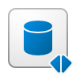
Query Acceleration
Query data in OneLake in-place with shortcuts
Automatic on the fly indexing and caching
At par performance with ingestion
Supports Delta as well as Iceberg (with xtable)
Warehouse
Accelerated Shortcut
Eventhouse
Lakehouse
Mirrored DB
Example:
KQL Command
1
2
.alter external table MyExternalTable policy query_acceleration '{"IsEnabled": true, "Hot": "1.00:00:00"}'
Notes:
Query acceleration indexes and caches data landing in OneLake on the fly, allowing customers to run performant queries on large volumes of data. Customers can use this capability to analyze real-time streams coming directly into Eventhouse and combine it with data landing in OneLake either coming from mirrored databases, Warehouses, Lakehouses or Spark.
When creating a shortcut from an Eventhouse to a OneLake delta table, users can choose if they want to accelerate the shortcut. Accelerating the shortcut means equivalent ingestion into the Eventhouse: indexing, caching, other optimizations that deliver the same level of performance for accelerated shortcuts as native Eventhouse tables.
By using this feature, you can accelerate data landing in OneLake, including existing data and any new updates. This eliminates the need to manage ingestion pipelines, maintain duplicate copies of data, while ensuring that data remains in sync without additional effort.
When using accelerated OneLake shortcuts, all data management is done by the data writer and in the Eventhouse the accelerated table shortcut, like any other shortcut is read only.
Customers can expect significant performance improvements by enabling this capability, in some cases up to 50x and beyond.

Slide 20



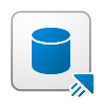
Eventhouse Shortcuts
Scenario
Share data within the company
Load balancing
Ring fencing
Data-as-a-service
Chargeback
Share data with partners
Data sharing in near-real-time
Share data with customers
Data sharing in near-real-time
Extend your business model
Combines data received from multiple business partners with its own data to derive insights
Data Provider’s Tenant
Market data
Azure Data
Explorer
Eventhouse
Data Consumer’s Tenant
Other Data Consumers
Market data from
provider 1
Microsoft
Fabric
Microsoft Fabric
Microsoft Fabric
Company Financials
(private dataset)
Analyze
Market data from
provider 2
KQL DB
Market data
Market data
Notes:
Cross Organization Big Data analytics. In all industries we have seen needs for data sharing between partners. For example, retailers share sales data with consumer goods suppliers who then use the data to do demand forecasting. In automotive space, we have seen car OEMs sharing IOT data with service providers. Oil and gas companies are sharing data with equipment and infrastructure providers. In precision agriculture, service providers deploy sensors to the field and share soil data with farmers to make watering/fertilizing decisions. In financial industries, index data, transaction data are shared to financial institutions and hedge funds, and sometimes monetized. In health care and education sector, anonymous patient data is shared to research cure for diseases. Governments are sharing data between agencies and with commercial companies.
So in this example a A financial data provider was interested in reducing operational inefficiencies with their legacy data delivery channels and making it easier for the end customers to seamlessly access large new datasets.

Slide 21
OneLake Availability
Mirroring of Eventhouse natively ingested data into OneLake as Delta tables
Scoped to Database or Tables
Does not apply to Materialized Views
Accessible by creating a shortcut from a Lakehouse to Eventhouse
Backfill for existing data and tables
Turn ON/OFF soft-deletes data
Adaptive behaviour based on data volume
By default, the write operation can take up to 3 hours or until files of sufficient size (typically 200-256 MB) are created.
You can adjust the delay to a value between 5 minutes and 3 hours.

Slide 22

Eventhouse (incl. KQL Databases)
Eventhouse
REST API
KQL Database (1… n)
KQL Queryset
Update Policies
Ingestion
Real-Time Dashboard
Native Table
Native Table
Materialized View
Serilog
Nlog
SDKs & Logging Frameworks
Semantic Model
Power BI Report
Accelerated Shortcut
Python + Spark Notebook
External Table
OneLake Delta Tables
KQL Database (1… n)
Data Agent
Shortcut
Copilot
Azure Data Explorer
or Eventhouse
Followed Table
Eventstream

Slide 23
Optimizations and Tuning
Cache
Callout
Capacity
Ingestion batching
Ingestion time
Merge
Partitioning
Retention
Extent tags retention
Query Results Cache
Row level security
Streaming ingestion
Update
Query weak consistency
Data Purge & Soft Delete
Joins Performance
System Information
Notes:
Policies are control commands that control and manage a wide range of operations from cluster level to table level. Operations such as
controlling and managing the computational resources,
defining the batches for data ingestion,
table sharding and growth parameters,
defining the timespan for data retention by various database objects,
Defining the row level security to grant access, Anonymize data, restrict access are all possible by defining policies either on the server level or on the object level.
We will cover Update policy in detail next

Slide 24
Query results cache
Basics
Helps preserve cluster resources for frequently executed queries
Improves responsiveness (user-perceived latencies)
Queries must be the same, letter-to-letter, to be served from cache
Caching period is configurable
Not compatible with tables that have row-level security enabled
The cache capacity is currently fixed at 1GB per node and query results doesn’t exceed 16MB.
Usage scenarios
Populating dropdowns in dashboards
Business reporting scenarios where staleness is acceptable
Not a good fit for monitoring dashboards where reaction time to spike/dip is critical
Kusto
1
2
3
set query_results_cache_max_age = time(5m);
MyTable
| distinct MyColumn //your expensive query
Notes:
However, this performance comes at the expense of some "staleness" in the results. Ref: https://docs.microsoft.com/azure/data-explorer/kusto/query/query-results-cache
Additionally, can:
.show database cache query_results
and
.clear database cache queryresults
Shard level query results cache
is effective when the exact same query is run multiple times in rapid succession and can tolerate returning slightly old data
set query_results_cache_per_shard;
GithubEvent
| where CreatedAt > ago(180d)
| summarize arg_max(CreatedAt, Type) by Id

Slide 25
Partitioning policy
Basics
Defines how extents (data shards) should be partitioned for a specific table or a materialized view.
By default, extents are partitioned by their ingestion time, and in most cases there's no need to set a partitioning policy.
Usage scenarios
Filters on mid/high cardinality string column, ie. TenantId or MetricId.
Aggs or joins on high cardinality group-by string column, ie. At least 10M distinct values.
Filtering out-of-order data by datetime column.
Caution: Adds overhead. Not recommended, if compressed data per partition is less than 1GB. Review the recommendations for materialized views partitioning policy.
See more: .alter table partitioning policy
Notes:
Filters
Strings Medium cardinality is at least 10K distinct values.
Set the hash partition key to be the string column, and set the PartitionAssigmentMode property to uniform.
Aggs/Joins
High cardinality string column, at least 1M distinct values.
Set the hash partition key to be the grouped-by column column, and set the PartitionAssigmentMode property to default.
Out-of-oder
Due to a backfill from heterogeneous source files that include datetime values over a large time span.
Set the uniform range datetime partition key to be the datetime column.
If you need retention and caching policies to align with the datetime values

Slide 26
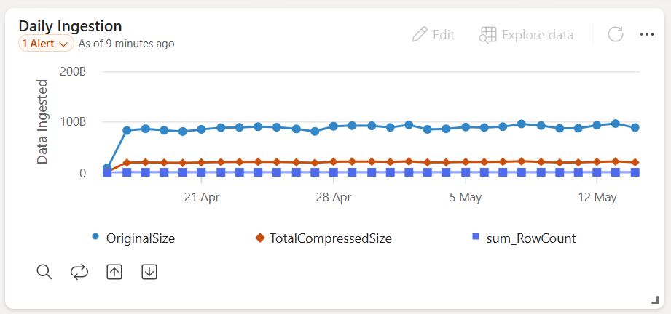
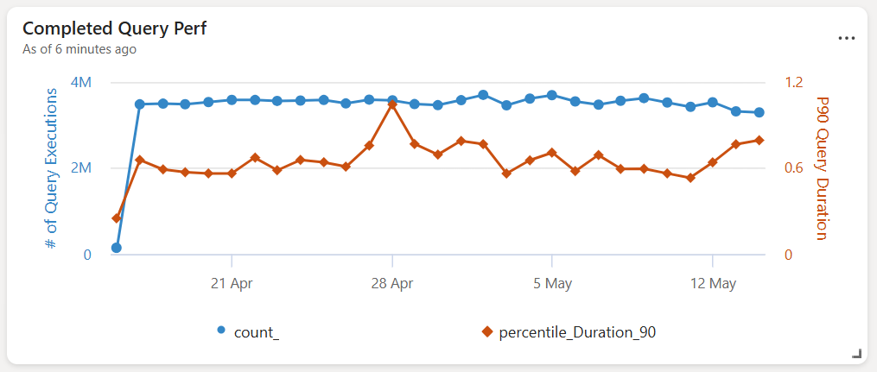
Customer’s production status now
100GB /day
3M queries/day in <0.8s

Slide 27
Row Level Security (RLS)
Basics
Evaluates a predicate based on AAD UPN or group membership and returns a restricted view of the underlying table.
Access restriction logic sits in the database tier, rather than in application tier.
Can’t be enabled on a table with continuous data export, referenced by a query of an update policy, on which restricted view access policy is configured or another RLS policy is enabled.
Usage scenarios
Granting access to subset of data – e.g., we might want to restrict engineers to only app data they actively debug, or in a multitenant scenario to restrict tenants to see only their data in a shared table.
Data Masking – e.g., PII data, only last four digits of credit card
Notes:
Ref: https://docs.microsoft.com/azure/data-explorer/kusto/management/rowlevelsecuritypolicy
Examples:
Limit access to a table, rows, and/or mask columns.
Slight increases the duration of an RLS query will normally consist of two parts:
Membership checks in Azure Active Directory
The filters applied on the data

Slide 28
Row Level Security (RLS)
Example:
Kusto
1
2
3
4
5
6
7
8
9
10
//Example of RLS statement
.create-or-alter function RLSFunction() {
let IsManager=current_principal_is_member_of("aadgroup=managers@company.com");
let AllData=MyTable | where IsManager;
let PartialData=MyTable | where not(IsManager) and UserColumn==current_principal();
union AllData, PartialData
}
//and applied to a table
.alter table MyTable policy row_level_security enable "RLSFunction()"
Notes:
Ref: https://docs.microsoft.com/azure/data-explorer/kusto/management/rowlevelsecuritypolicy

Slide 29
Join with shuffle to improve performance
It is better to use when the shuffle key (join key) has a high cardinality and the regular operator hits query limits. For example:
Left-side has 15M records, cardinality of the join key is ~14M.
Right-side has 150M records, cardinality of the join key is 10M
7x faster with shuffle and 5x less memory.
Shuffle partitions data such that number of partitions is equal to the number of cluster nodes. If you observe query timeouts or query fails to complete, you can increase the partition count via hint.num_partitions = x. Please increase the number of partitions gradually as too large number might lead to degraded performance.
Kusto
1
2
3
4
5
customer
| join hint.strategy = shuffle
orders
on $left.c_custkey == $right.o_custkey
| summarize sum(c_acctbal) by c_nationkey
Notes:
You can use the following operators with the shuffle command:
join
summarize
make-series
partition

Slide 30
KQL Query Best Practices: Make your query run faster
Action | Use | Don’t use | Notes
Filtering | A table column | Don’t filter on a calculated column.
summarize | hint.strategy=shuffle when the group by keys are high cardinality |  | High cardinality is ideally above 1 million
join | Table with fewer rows first (left-side in query)
Join across clusters | Run the query on the cluster where most of the data resides. | Don’t filter on a calculated column
Left is small and Right is large (joins) | Use hint.strategy=broadcast |  | Small means <= 100,000 records
Notes:
Ref: https://docs.microsoft.com/en-us/azure/data-explorer/kusto/query/best-practices

Slide 31
System information
Commands available to Database Admins and Database Monitors roles.
.show queries - displays information on completed and running queries.
.show commands - displays information on completed commands and their resources utilization.
.show commands-and-queries - displays information on completed commands and queries, and their resources utilization.
.show journal - displays history of the metadata operations.
.show operations - displays administrative operations both running and completed, since Admin node was last elected.
.show ingestion failures - displays information on failures encountered during data ingestion to the cluster.
.show table data statistics - displays table data statistics per column.
Notes:
Ref: https://docs.microsoft.com/azure/data-explorer/troubleshoot-create-cluster
1. Ensure you have adequate permissions. To create a cluster, you must be a member of the Contributor or Owner role for the Azure subscription. If necessary, work with your subscription administrator so they can add you to the appropriate role.
2. Ensure that there are no validation errors related to the cluster name you entered under Create cluster in the Azure portal.
3. Check the Azure service health dashboard. Look for the status of Azure Data Explorer in the region where you're trying to create the cluster.
4. If the status isn't Good (green check mark), try creating the cluster after the status improves.
5. If you still need assistance solving your issue, please open a support request in the Azure portal.
Ref: https://docs.microsoft.com/azure/data-explorer/troubleshoot-connect-cluster
Ensure the connection string is correct. It should be in the form: https://<ClusterName>.<Region>.kusto.windows.net, such as the following example: https://docscluster.westus.kusto.windows.net.
2. Ensure you have adequate permissions. If you don't, you'll get a response of unauthorized.
For more information about permissions, see Manage database permissions. If necessary, work with your cluster administrator so they can add you to the appropriate role.
3. Verify that the cluster hasn't been deleted: review the activity log in your subscription.
4. Check the Azure service health dashboard. Look for the status of Azure Data Explorer in the region where you're trying to connect to a cluster.
If the status isn't Good (green check mark), try connecting to the cluster after the status improves.
5. If you still need assistance solving your issue, please open a support request in the Azure portal.
Creating a database
Ensure you have adequate permissions. To create a database, you must be a member of the Contributor or Owner role for the Azure subscription. If necessary, work with your subscription administrator so they can add you to the appropriate role.
Ensure that there are no name validation errors for the database name. The name must be alphanumeric, with a maximum length of 260 characters.
Ensure that the database retention and caching values are within allowable ranges. Retention must be between 1 and 36500 days (100 years). Caching must be between 1 and the maximum value set for retention.
Deleting or renaming a database
Ensure you have adequate permissions.
To delete or rename a database, you must be a member of the Contributor or Owner role for the Azure subscription. If necessary, work with your subscription administrator so they can add you to the appropriate role.
You can also delete or rename a database if you have the database admin role.
Creating a table
Ensure you have adequate permissions. To create a table, you must be a member of the database admin or database user role in the database or the Contributor or Owner role for the Azure subscription. If necessary, work with your subscription or cluster administrator so they can add you to the appropriate role.
For more information about permissions, see Manage database permissions.
Ensure that a table with the same name doesn't already exist. If it exists, then you can: Create a table with a different name; rename the existing table (requires table admin role); or drop the existing table (requires database admin role). Use the following commands.
.drop table <TableName>
.rename table <OldTableName> to <NewTableName>
Deleting or renaming a table
Ensure you have adequate permissions.
To delete or rename a table, you must be a member of the database admin or table admin role in the database. If necessary, work with your subscription or cluster administrator so they can add you to the appropriate role.
For more information about permissions, see Manage database permissions.
https://docs.microsoft.com/en-us/azure/data-explorer/troubleshoot-database-table

Slide 32
Hidden Complexity
Behind the scenes:
Power BI maintains a query cache even for DirectQuery datasets.
Dual-mode tables automatically switch modes depending on query patterns.
Advanced users can parameterize KQL queries via M dynamic parameters for multi-tenant or on-demand filtering.

Slide 33
Eventstream Internals
Core Focus: Buffering, parallelization, schema evolution, and latency management
Ingested data from streaming sources is processed via partitioned pipelines, often aligned to source partitions (e.g., Kafka topics).
Eventstream introduces a controlled buffer delay (typically ~10 seconds) to enable multi-sink routing and enrichment.
Supports schema inference and evolution, allowing downstream systems to adapt to changes in the payload shape.
Event delivery is parallelized but respects ordering guarantees per partition.
Implication: Changes in source schemas, burst traffic, or improperly filtered data can delay or disrupt downstream pipelines.

Slide 34
Analytics

Slide 35






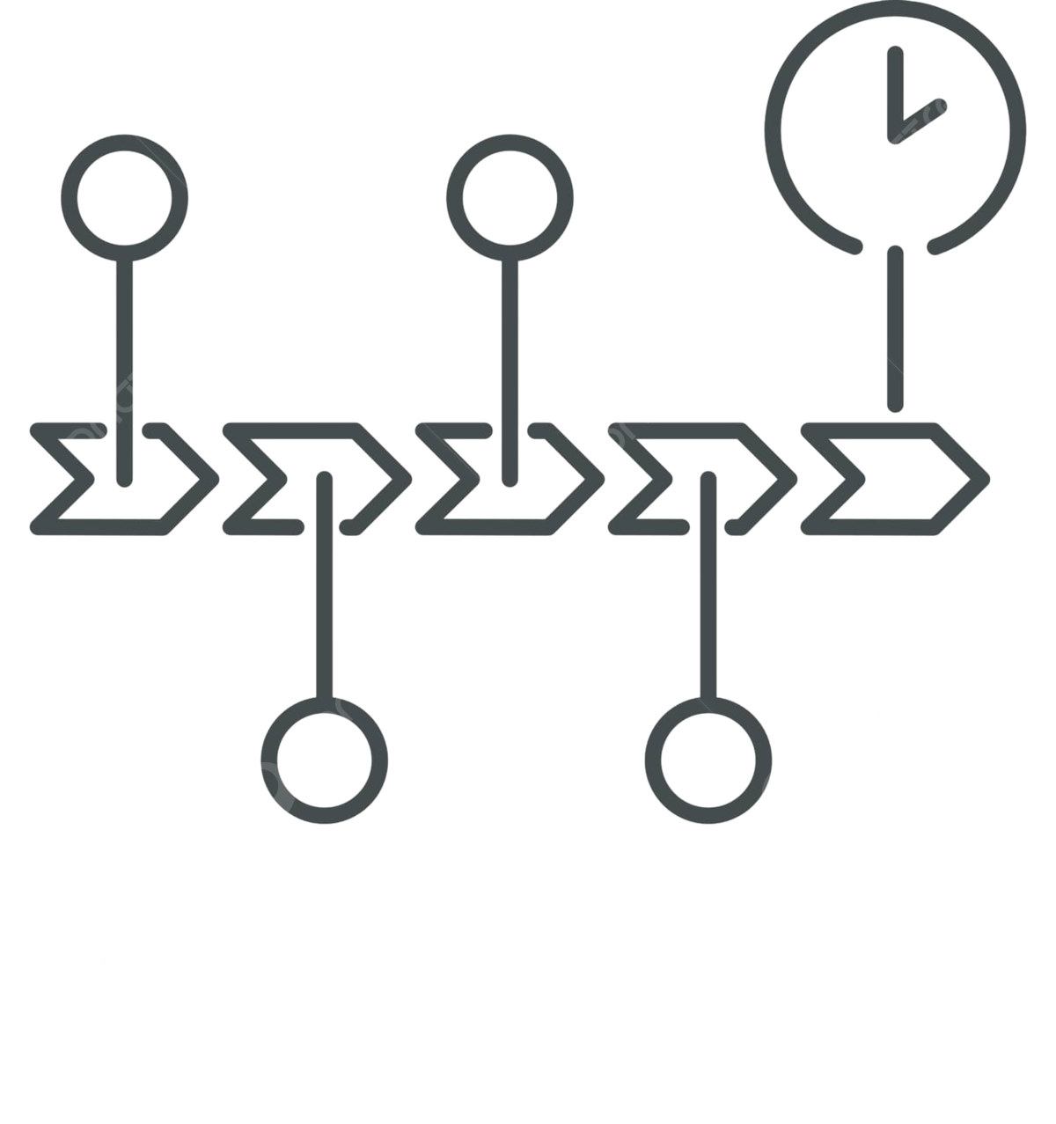

Comprehensive analytics & AI capabilities
Logs
Events
Timeseries
Geospatial
Graph
Sequence
(Process mining)
Vector
Notes:
LoB is interested in timeseries and geospatial data
Security & IT is interested in logs + events
Data team is interested in events + logs + graph for monitoring PBI + Databricks workspaces
GenAI developers are interested in vector search capabilities..

Slide 36
Anomaly detection and forecasting
Anomaly detection and forecasting in Kusto Query Language (KQL) are powerful tools for identifying unusual behavior and predicting future trends in time-series data. These capabilities are essential in use cases like application performance monitoring, security event detection, telemetry analysis, and resource usage forecasting.
KQL provides native support for statistical methods such as moving averages, time series decomposition, and seasonality detection, which can be used in real-time or retrospective analysis of large-scale datasets.
STEP 1
STEP 2
STEP 3
Time Series preparation
Anomaly Detection with series_decompose_anomalies()
Forecasting with series_decompose_forecast()
MyMetricsTable
| make-series avgCPU=avg(CPU_Usage) on Timestamp in range(startofday(ago(7d)), now(), 1h)
MyMetricsTable
| make-series avgCPU=avg(CPU_Usage) on Timestamp in range(startofday(ago(7d)), now(), 1h)
| extend anomalies = series_decompose_anomalies (avgCPU, 3, -1, 'linefit')
MyMetricsTable
| make-series avgCPU=avg(CPU_Usage) on Timestamp in range(startofday(ago(14d)), now(), 1h)
| extend (forecast, lower, upper) = series_decompose_forecast (avgCPU, 24)

Slide 37
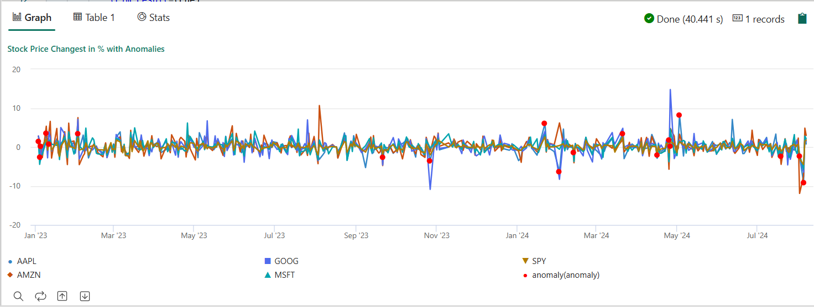
Multivariate anomaly detection
Univariate anomaly detection, which is implemented by the KQL function series_decompose_anomalies(), enables you to monitor and detect anomalies in the distribution of a single variable over time.
In contrast, multivariate anomaly detection is a method of detecting anomalies in the joint distribution of multiple variables over time. This method is useful when the variables are correlated, thus the combination of their values at specific time might be anomalous, while the value of each variable by itself is normal.
Multivariate anomaly detection can be used in various applications, such as monitoring the health of complex IoT systems, detecting fraud in financial transactions, and identifying unusual patterns in network traffic.

Slide 38
JSON and XML parsing
Kusto Query Language (KQL) offers built-in capabilities for parsing and querying semi-structured data formats like JSON and XML, which are commonly found in logs, telemetry, and API responses. These features allow users to extract meaningful values from complex or nested data without needing to preprocess the data outside of KQL.
JSON is particularly prevalent in modern cloud-native environments (e.g., application logs, Azure diagnostics), while XML may appear in legacy systems or structured logging frameworks.
JSON
datatable(log: string)
[
'{"user":"alice","action":"login","meta":{"ip":"192.168.1.1","device":"mobile"}}'
]
| extend log_json = parse_json(log)
| project user = log_json.user, ip = log_json.meta.ip, device = log_json.meta.device

Slide 39
JSON and XML parsing
Kusto Query Language (KQL) offers built-in capabilities for parsing and querying semi-structured data formats like JSON and XML, which are commonly found in logs, telemetry, and API responses. These features allow users to extract meaningful values from complex or nested data without needing to preprocess the data outside of KQL.
JSON is particularly prevalent in modern cloud-native environments (e.g., application logs, Azure diagnostics), while XML may appear in legacy systems or structured logging frameworks.
JSON
XML
datatable(log: string)
[
'{"user":"alice","action":"login","meta":{"ip":"192.168.1.1","device":"mobile"}}'
]
| extend log_json = parse_json(log)
| project user = log_json.user, ip = log_json.meta.ip, device = log_json.meta.device
let xml = "<log><user>bob</user><action>logout</action></log>";
print user = extract("<user>(.*?)</user>", 1, xml)

Slide 40
JSON and XML parsing
Scans data, matches, and builds sequences based on the predicates.
Matching records are determined according to predicates defined in the operator’s steps. A predicate can depend on the state that is generated by previous steps. The output for the matching record is determined by the input record and assignments defined in the operator's steps.
The underlying state of the scan operator can be thought of as a table with a row for each step. Each step maintains its own state with the latest values of the columns and declared variables from all of the previous steps and the current step. If relevant, it also holds the match ID for the ongoing sequence.
Non-exhaustive example usage:
Cumulative sum
Fill forward a column
Sessions tagging
Custom funnel
Calculate the cumulative sum for an input column. The result of this example is equivalent to using row_cumsum()
Fill forward a string column. Each empty value is assigned the last seen nonempty value.
Divide the input into sessions: a session ends 30 minutes after the first event of the session, after which a new session starts. Note the use of with_match_id flag, which assigns a unique value for each distinct match (session) of scan.
Calculate a funnel completion of the sequence Hail -> Tornado -> Thunderstorm Wind by State with custom thresholds on the times between the events (Tornado within 1h and Thunderstorm Wind within 2h).

Slide 41
Time series creation
Create a large set of regular time series simply and intuitively using the make-series operator, and fill-in missing values as needed.
The first step in time series analysis is to partition and transform the original telemetry table to a set of time series.
The table usually contains a timestamp column, contextual dimensions, and optional metrics.
CLICK TO RUN QUERY
Kusto
1
demo_make_series1 | take 10

Slide 42
Time series creation
Create a large set of regular time series simply and intuitively using the make-series operator, and fill-in missing values as needed.
The first step in time series analysis is to partition and transform the original telemetry table to a set of time series.
The table usually contains a timestamp column, contextual dimensions, and optional metrics.
Kusto
1
demo_make_series1 | take 10

Slide 43
Time series creation
Since there are no metrics, we can only build a set of time series representing the traffic count, by OS.
Kusto
1
2
3
4
5
6
let min_t = toscalar(demo_make_series1 | summarize min(TimeStamp));
let max_t = toscalar(demo_make_series1 | summarize max(TimeStamp));
demo_make_series1
| make-series num=count() default=0 on TimeStamp in range(min_t, max_t, 1h) by OsVer
| render timechart
Notes:
Use the make-series operator to create a set of three time series, where:
num=count(): time series of traffic
from min_t to max_t step 1h: time series is created in 1-hour bins in the time range (oldest and newest timestamps of table records)
default=0: specify fill method for missing bins to create regular time series. Alternatively use series_fill_const(), series_fill_forward(), series_fill_backward() and series_fill_linear() for changes
By OsVer: partition by OS
The actual time series data structure is a numeric array of the aggregated value per each time bin. We use render timechart for visualization.
In the table above, we have three partitions. We can create a separate time series: Windows 10 (red), 7 (blue) and 8.1 (green) for each OS version as seen in the graph:

Slide 44
Filtering
Filtering is a common practice in signal processing and useful for time series processing tasks (for example, smooth a noisy signal, change detection).
CLICK TO RUN QUERY
Kusto
1
2
3
4
5
6
7
let min_t = toscalar(demo_make_series1 | summarize min(TimeStamp));
let max_t = toscalar(demo_make_series1 | summarize max(TimeStamp));
demo_make_series1
| make-series num=count() default=0 on TimeStamp in range(min_t, max_t, 1h) by OsVer
| extend ma_num=series_fir(num, repeat(1, 5), true, true)
| render timechart
Notes:
There are two generic filtering functions:
series_fir(): Applying FIR filter. Used for simple calculation of moving average and differentiation of the time series for change detection.
series_iir(): Applying IIR filter. Used for exponential smoothing and cumulative sum.
Extend the time series set by adding a new moving average series of size 5 bins (named ma_num) to the query:

Slide 45
Regression analysis
Eventhouse supports segmented linear regression analysis to estimate the trend of the time series.
Use series_fit_line() to fit the best line to a time series for general trend detection.
Use series_fit_2lines() to detect trend changes, relative to the baseline, that are useful in monitoring scenarios.
CLICK TO RUN QUERY
Kusto
1
2
3
demo_series2
| extend series_fit_2lines(y), series_fit_line(y)
| render linechart with(xcolumn=x)
Notes:
Blue: original time series
Green: fitted line
Red: two fitted lines
Note: The function accurately detected the jump (level change) point.

Slide 46
Seasonality detection
Many metrics follow seasonal (periodic) patterns.
User traffic of cloud services usually contains daily and weekly patterns that are highest around the middle of the business day and lowest at night and over the weekend.
Measurements such as temperature, pressure, or humidity may also show seasonal behavior.
CLICK TO RUN QUERY
Kusto
1
2
3
4
5
6
7
demo_series3
| render timechart;
demo_series3
| project (periods, scores) = series_periods_detect(num, 0., 14d/2h, 2)
| mv-expand periods, scores
| extend days=2h*todouble(periods)/1d
Notes:
Use series_periods_detect() to automatically detect the periods in the time series.
Use series_periods_validate() if we know that a metric should have specific distinct period(s) and we want to verify that they exist.
Note: It's an anomaly if specific distinct periods don't exist
Line 5 is used to detect the periods in the time series

Slide 47
Element-wise functions
Arithmetic and logical operations can be done on a time series.
Using series_subtract() we can calculate a residual time series, that is, the difference between original raw metric and a smoothed one, and look for anomalies in the residual signal:
CLICK TO RUN QUERY
Kusto
1
2
3
4
5
6
7
8
9
let min_t = toscalar(demo_make_series1 | summarize min(TimeStamp));
let max_t = toscalar(demo_make_series1 | summarize max(TimeStamp));
demo_make_series1
| make-series num=count() default=0 on TimeStamp in range(min_t, max_t, 1h) by OsVer
| extend ma_num=series_fir(num, repeat(1, 5), true, true)
| extend residual_num=series_subtract(num, ma_num)
| where OsVer == "Windows 10"
| render timechart
Notes:
Line 6 calculates the residual time series
Line 8 filters on Win 10 to visualize a cleaner chart
Blue: original time series
Red: smoothed time series
Green: residual time series

Slide 48
Time series at scale
These functions can run at scale on thousands of time series in seconds for anomaly detection.
These advanced capabilities combined with Azure Data Explorer fast performance supply a unique and powerful solution for time series analysis.
CLICK TO RUN QUERY
Kusto
1
2
3
4
5
6
7
8
let min_t = toscalar(demo_many_series1 | summarize min(TIMESTAMP));
let max_t = toscalar(demo_many_series1 | summarize max(TIMESTAMP));
demo_many_series1
| make-series reads=avg(DataRead) on TIMESTAMP in range(min_t, max_t, 1h) by Loc, Op, DB
| extend (rsquare, slope) = series_fit_line(reads)
| top 2 by slope asc
| project Loc, Op, DB, slope
Notes:
See a few sample telemetry records of a DB service's read count metric over 4 days.
In less than two minutes, Azure Data Explorer analyzed close to 20,000 time series and detected two abnormal time series in which the read count suddenly dropped.

Slide 49
Anomaly detection and forecasting in Eventhouse
Contains native support for creation, manipulation, and analysis of multiple time series.
The applicable time series functions are based on a robust well-known decomposition model, where each original time series is decomposed into seasonal, trend, and residual components.
Anomalies are detected by outliers on the residual component, while forecasting is done by extrapolating the seasonal and trend components.
Significantly enhances the basic decomposition model by automatic seasonality detection, robust outlier analysis, and vectorized implementation to process thousands of time series in seconds.

Slide 50
Decomposition model
Is applied to time series of metrics expected to manifest periodic and trend behavior, such as service traffic, component heartbeats, and IoT periodic measurements to forecast future metric values and detect anomalous ones.
The assumption of this regression process is that other than the previously known seasonal and trend behavior, the time series is randomly distributed.
Can detect anomalous values based on outlier analysis using only the residual portion.
To create a decomposition model, use the function series_decompose(). It takes a set of time series and automatically decomposes each time series to its seasonal, trend, residual, and baseline components.
Notes:
Azure Data Explorer native implementation for time series prediction and anomaly detection uses a well-known decomposition model. This model is applied to time series of metrics expected to manifest periodic and trend behavior, such as service traffic, component heartbeats, and IoT periodic measurements to forecast future metric values and detect anomalous ones. The assumption of this regression process is that other than the previously known seasonal and trend behavior, the time series is randomly distributed. You can then forecast future metric values from the seasonal and trend components, collectively named baseline, and ignore the residual part. You can also detect anomalous values based on outlier analysis using only the residual portion. To create a decomposition model, use the function series_decompose(). The series_decompose() function takes a set of time series and automatically decomposes each time series to its seasonal, trend, residual, and baseline components.

Slide 51
Decomposition model
For example, you can decompose traffic of an internal web service by using the following query:
CLICK TO RUN QUERY
Kusto
1
2
3
4
5
6
7
8
9
10
let min_t = datetime(2017-01-05);
let max_t = datetime(2017-02-03 22:00);
let dt = 2h;
demo_make_series2
| make-series num=avg(num) on TimeStamp from min_t to max_t step dt by sid
| where sid == 'TS1'
| extend (baseline, seasonal, trend, residual) = series_decompose(num, -1, 'linefit')
| render timechart with(title='Web app. traffic of a month, decomposition', ysplit=panels)
Notes:
Line 6 (where) // select a single time series for a cleaner visualization
Line 7 (extend) // decomposition of a set of time series to seasonal, trend, residual, and baseline (seasonal+trend)

Slide 52
Anomaly detection
The function series_decompose_anomalies() finds anomalous points on a set of time series.
This function calls series_decompose() to build the decomposition model and then runs series_outliers() on the residual component.
series_outliers() calculates anomaly scores for each point of the residual component using Tukey's fence test. Anomaly scores above 1.5 or below -1.5 indicate a mild anomaly rise or decline.
Anomaly scores above 1.5 or below -1.5 indicate a mild anomaly rise or decline. Scores above 3.0 or below -3.0 indicate a strong anomaly.
Notes:
Azure Data Explorer native implementation for time series prediction and anomaly detection uses a well-known decomposition model. This model is applied to time series of metrics expected to manifest periodic and trend behavior, such as service traffic, component heartbeats, and IoT periodic measurements to forecast future metric values and detect anomalous ones. The assumption of this regression process is that other than the previously known seasonal and trend behavior, the time series is randomly distributed. You can then forecast future metric values from the seasonal and trend components, collectively named baseline, and ignore the residual part. You can also detect anomalous values based on outlier analysis using only the residual portion. To create a decomposition model, use the function series_decompose(). The series_decompose() function takes a set of time series and automatically decomposes each time series to its seasonal, trend, residual, and baseline components.

Slide 53
Anomaly detection
The following query allows you to detect anomalies in internal web service traffic:
CLICK TO RUN QUERY
Kusto
1
2
3
4
5
6
7
8
9
10
let min_t = datetime(2017-01-05);
let max_t = datetime(2017-02-03 22:00);
let dt = 2h;
demo_make_series2
| make-series num=avg(num) on TimeStamp from min_t to max_t step dt by sid
| where sid == 'TS1'
| extend (anomalies, score, baseline) = series_decompose_anomalies(num, 1.5, -1, 'linefit')
| render anomalychart with(anomalycolumns=anomalies, title='Web app. traffic of a month, anomalies')
Notes:
Line 6 (where) // select a single time series for a cleaner visualization
Line 7 (extend) // decomposition of a set of time series to seasonal, trend, residual, and baseline (seasonal+trend)

Slide 54
Forecasting
The function series_decompose_forecast() predicts future values of a set of time series.
This function calls series_decompose() to build the decomposition model and then, for each time series, extrapolates the baseline component into the future.
CLICK TO RUN QUERY
Kusto
1
2
3
4
5
6
7
8
9
10
let min_t = datetime(2017-01-05);
let max_t = datetime(2017-02-03 22:00);
let dt = 2h;
let horizon = 7d;
demo_make_series2
| make-series num=avg(num) on TimeStamp from min_t to max_t+horizon step dt
by sid
| where sid == 'TS1'
| extend forecast = series_decompose_forecast(num, toint(horizon/dt))
| render timechart with(title='Traffic of a month + forecasting next week')
Notes:
The following query allows you to predict next week's web service traffic.

Slide 55
Scalability
Eventhouse allows for fast performance, which is critical for effective anomaly detection & forecasting over thousands of counters in near real-time.
CLICK TO RUN QUERY
Kusto
1
2
3
4
5
6
7
8
9
10
11
let min_t = datetime(2017-01-05);
let max_t = datetime(2017-02-03 22:00);
let dt = 2h;
let horizon = 7d;
demo_make_series2
| make-series num=avg(num) on TimeStamp from min_t to max_t+horizon step dt by sid
| extend offset=case(sid=='TS3', 4000000, sid=='TS2', 2000000, 0)
| extend num=series_add(num, offset)
| extend forecast = series_decompose_forecast(num, toint(horizon/dt))
| render timechart with(title='Traffic of a month + forecasting next week')
Notes:
The following query shows the processing of three time series simultaneously:

Slide 56
Eventhouse Language plugin: Python
Runs a user-defined function (UDF) using a Python script.
The Python script gets tabular data as its input, and produces tabular output.
The plugin's runtime is hosted in sandboxes, running on the cluster's nodes.
The plugin is disabled by default. Enable or disable the plugin in the Azure portal, in your cluster's Configuration tab.
The Python sandbox image is based on Anaconda 5.2.0 distribution with the Python 3.8 engine. See the list of Anaconda packages.
The Python image also contains common ML packages: tensorflow, keras, torch, hdbscan, xgboost, and other useful packages.
The plugin imports numpy (as np) & pandas (as pd) by default. You can import other modules as needed.
Notes:
Ref: https://docs.microsoft.com/azure/data-explorer/kusto/query/pythonplugin?pivots=azuredataexplorer
Note: A small percentage of packages might be incompatible with the limitations enforced by the sandbox where the plugin is run.
Use Ingestion from query and update policy
Use the plugin in queries that are:
Defined as part of an update policy, whose source table is ingested to using non-streaming ingestion.
Run as part of a command that ingests from a query, such as .set-or-append. In both these cases, verify that the volume and frequency of the ingestion, and the complexity and resources used by the Python logic, align with sandbox limitations and the cluster's available resources. Failure to do so may result in throttling errors.
You can't use the plugin in a query that is defined as part of an update policy, whose source table is ingested using streaming ingestion.

Slide 57
Python Examples
Kusto
1
2
3
4
5
6
7
8
9
10
11
12
range x from 1 to 360 step 1
| evaluate python(
typeof(*, fx:double), //Output schema: append a new fx column to original table
```
result = df
n = df.shape[0]
g = kargs["gain"]
f = kargs["cycles"]
result["fx"] = g * np.sin(df["x"]/n*2*np.pi*f)
```
, pack('gain', 100, 'cycles', 4) //dictionary of parameters
) | render linechart
Notes:
Must be first enabled for the cluster, takes approx. 10minutes.
#connect cluster('demo12.westus').database('AnimalTelemetryNetwork’)
Or connect to your own cluster that has the plugin enabled.
Enclose the full script between lines containing three consecutive backticks,

Slide 58
Visualization

Slide 59
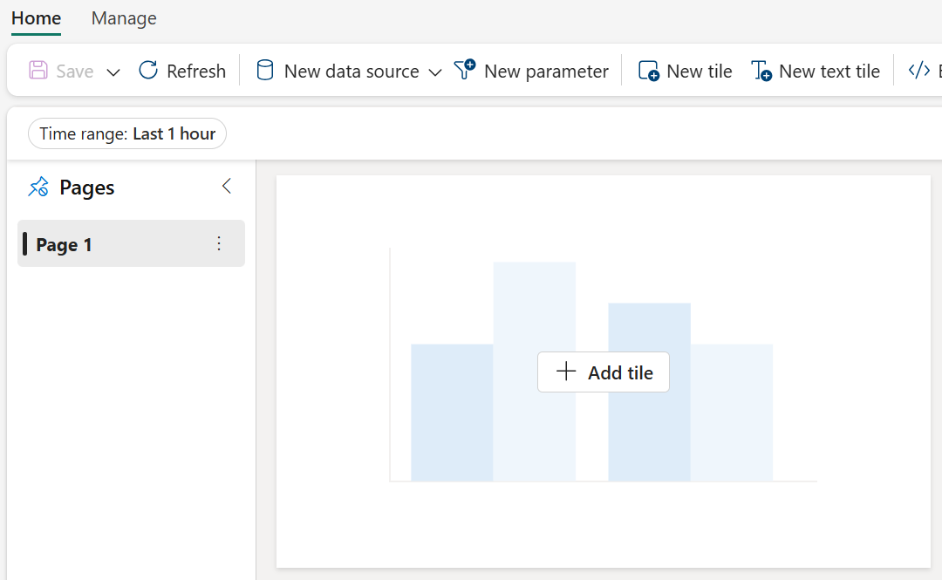
Real-Time Dashboard
Dashboard
1…n
Page
1…n
Tile
Operations
Operations
Operations
Create
Edit
Copy link
Manage Permissions
Duplicate
Delete
Forget
Export to File
Replace with File
Share
Create
Edit
Add tile
Add text
Data source(s)
Auto refresh
Parameters
Rename
Duplicate
Delete
Move
Create
Edit
Rename
Duplicate
Delete
Move
Notes:
ADX Dashboard is built on 3 fundamental objects:
Dashboard: This is the over-arching container that holds all the pages and charts inside each page.
Page: This is the next level aggregation of charts enabling you to logically groups your charts by topics, subjects, datasets, or any aspect of your interest.
Tile: Each tile is a chart that represents the visualization of the underlying dataset.
Each object provides different set of operations to edit, share, manage the collections of charts and dashboards.

Slide 60
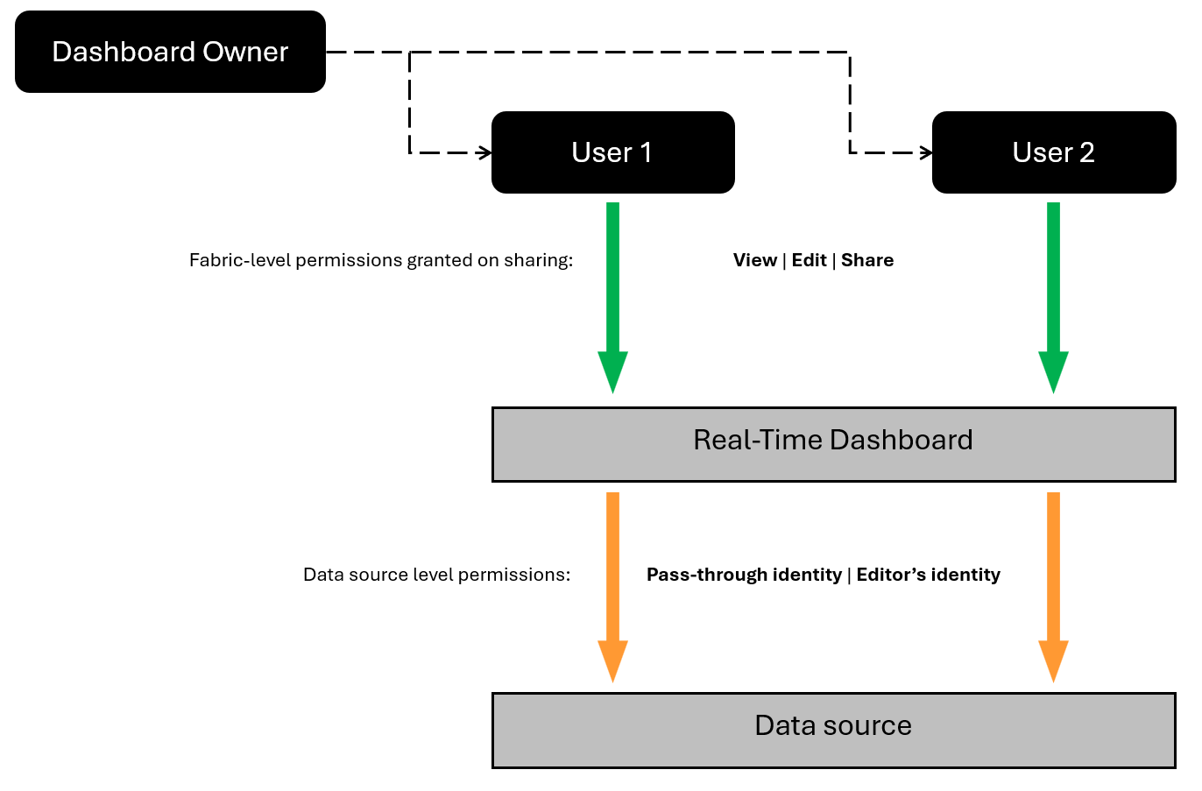
Real-Time Dashboard Sharing
Pass-through identity:
Default setting
User is able to view the data in the tiles if the have access to the underlying data source
Dashboard editor identity:
User can use the Dashboard`s editor identity & their permissions to access the underlying data source
If more than 1 editor, each needs to setup their own datasource.
Notes:
There are two types of permissions:
Fabric permissions: These permissions control the ability to view or edit a real-time dashboard when it's shared.
Data source permissions: These permissions control access to the underlying data used by a real-time dashboard.
When you share a real-time dashboard, you can specify if the user can view, edit, or share. These permissions are for the real-time dashboard itself and not the underlying data.

Slide 61
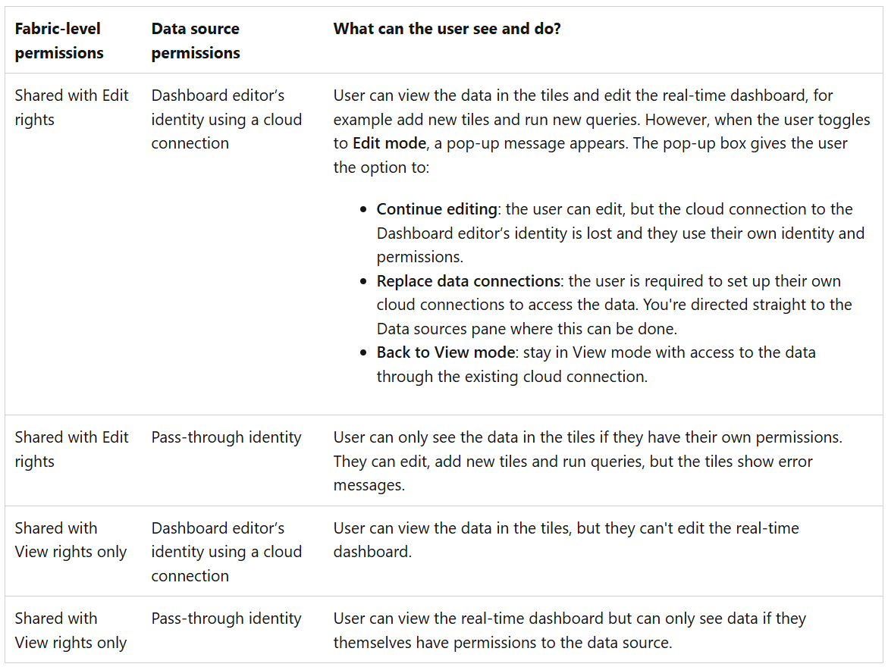

Slide 62
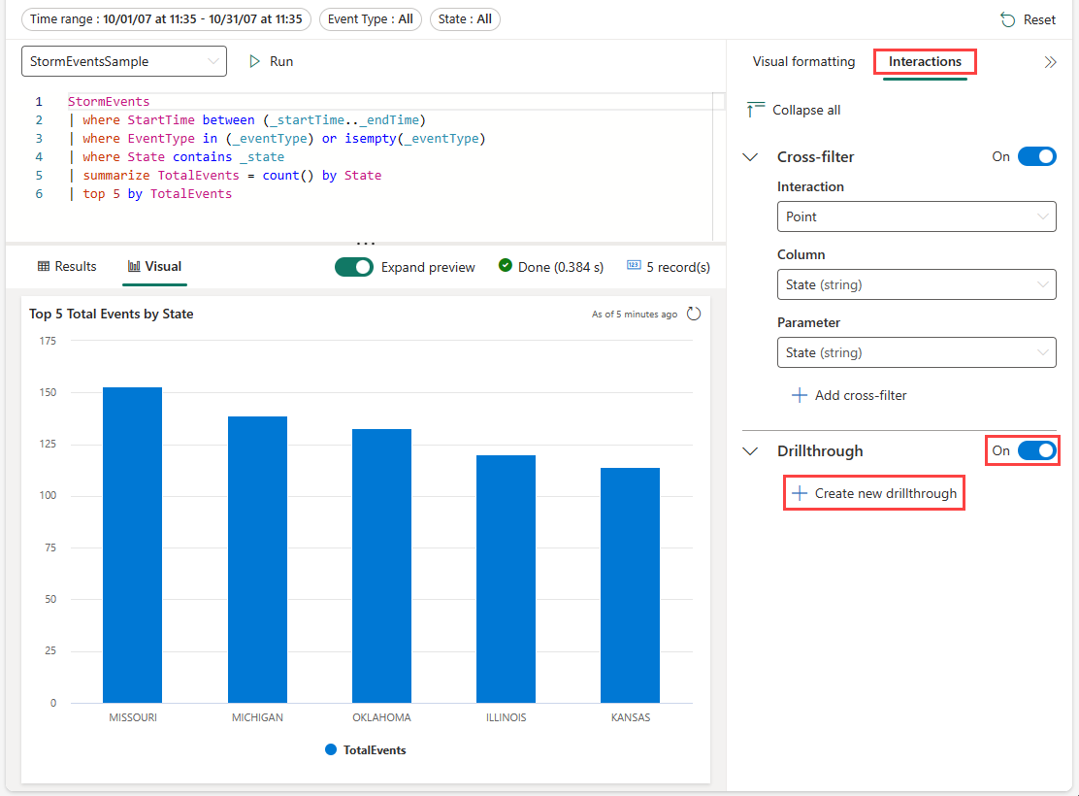
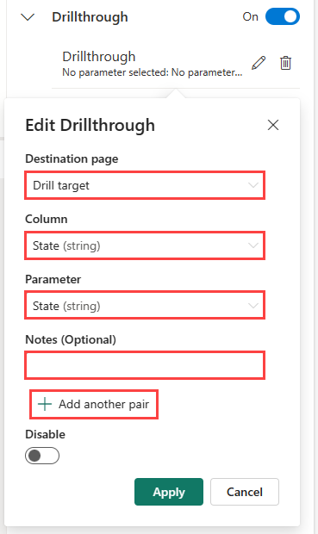
Use drillthroughs as dashboard parameters
Notes:
Drillthroughs allow you to select a value in a visual and use it to filter the visuals in a target page within the same dashboard. When the target page opens, the value is preselected in the relevant filters. The visuals on the page, such as line or scatter charts, are filtered to only show related data. This feature is useful for creating dashboards with drillthroughs from a summary page to a details page.

Slide 63
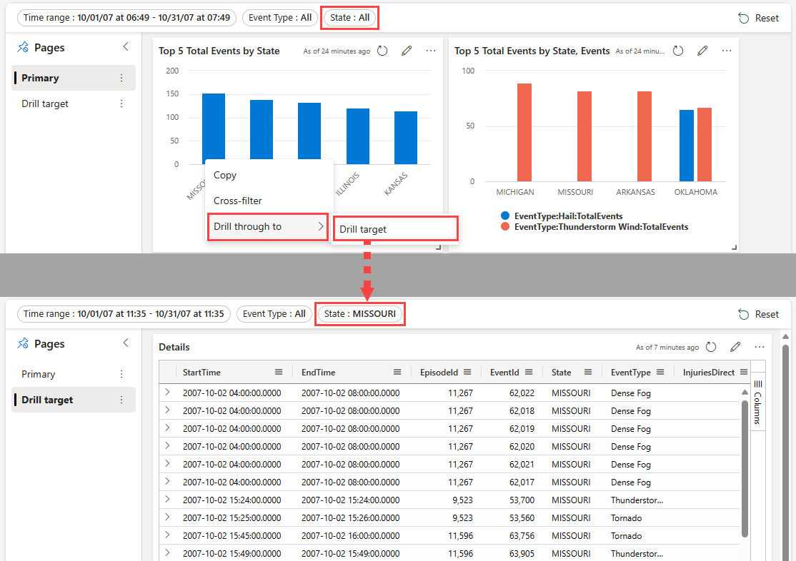
Use drillthroughs as dashboard parameters
Notes:
Once drillthroughs are defined, you can use them to interact with your data. To do so, in visuals or tables where you've defined a drillthrough, right-click on a data point, and then select Drill through to > destination page. The values from the data point are used as the parameters to filter the visuals on the target page.

Slide 64
Modeling for Power BI

Slide 65
Power BI Modes
Mode | Description | When to Use
DirectQuery | Queries the Eventhouse database live at query time. | Real-Time freshness is critical. Data size too large to fit in memory.
Import | Imports a static snapshot of the data into Power BI memory. | When query latency from Eventhouse is high, or high-performance dashboards needed.
Dual | Supports both import and DirectQuery dynamically. | Best of both worlds; for filtering and small lookups.
DirectLake | For lakehouse scenarios, not typical for KQL sources. | Only when sourcing via OneLake or Delta tables.

Slide 66
Storage Mode Strategy
Real-world guidance for fabric Real-Time Intelligence to Power BI modeling:
Table Type | Recommended Storage Mode | Reason
Fact Table (Events, Logs) | DirectQuery | Real-Time freshness; too big for import.
Small Dimensions (Lookup Tables) | Dual | Faster slicer/filtering; caches locally.
Large Dimensions | DirectQuery | If size > 1M rows and freshness needed.

Slide 67
Best practices for using Power BI with Eventhouse
Travel light - Bring only the data that you need for your reports to Power BI. For deep interactive analysis, use the Eventhouse Web UI that is optimized for ad-hoc exploration with the KQL.
Composite model - Use composite model to combine aggregated data for top-level dashboards with filtered operational raw data. You can clearly define when to use raw data and when to use an aggregated view.
Parallelism - improve the performance of dashboard rendering by increasing the parallelism of the end-to-end flow as follows:
Increase the number of concurrent connections in DirectQuery in Power BI.
Effective slicers – Use sync slicers to prevent reports from loading data before you're ready. After you structure the data set, place all visuals, and mark all the slicers, you can select the sync slicer to load only the data needed.
Use filters - Use as many Power BI filters to focus the Eventhouse search on the relevant data shards.
Efficient visuals – Select the most performant visuals for your data.
Notes:
Ref: https://docs.microsoft.com/azure/data-explorer/power-bi-best-practices

Slide 68
Handling DateTime Columns
Datetime modeling is non-trivial with KQL sources​​​:
Always treat DateTime columns as UTC.
Create a Calendar Table to filter by dates.
Use datetime_utc_to_local() only carefully (performance penalty if used extensively​).
Use relative time slicers in Power BI for "Last N hours/minutes" analysis​.
Example of generating a DateTime table (M Query):
let
StartDate = DateTime.From(Date.AddDays(DateTime.LocalNow(), -30)),TimeSeries = List.DateTimes(StartDate, 43200, #duration(0,0,1,0)),
#"Converted to Table" = Table.FromList(TimeSeries, Splitter.SplitByNothing(), {"Timestamp"})
in
#"Converted to Table"

Slide 69
Query Pushdown and Native Query
When using the Azure Eventhouse (Kusto) connector:
Native Query folding is supported: KQL runs server-side.
Avoid heavy Power Query (M) transformations post-load — push filtering and aggregation into KQL as much as possible.
Best practice: Model complex transformations as Kusto Functions inside Fabric and reference them from Power BI.

Slide 70
Monitoring Power BI Query Performance
In large Real-Time Intelligence solutions:
Use Performance Analyzer in Power BI Desktop.
Watch for slow DirectQuery requests.
Profile KQL query execution in Eventhouse side (.show queries).
Typical signs of bad modeling:
High row retrieval counts
Slow slicer/filter performance
Repeated queries without result reuse

Slide 71
Common Modeling Pitfalls
No star schema: Flat wide tables slow down slicers.
DirectQuery everything: Even for small dimension tables — causes unnecessary latency.
Local time conversions in visuals: Slows queries massively.
Missing relationships: Forces Power BI to do expensive cartesian joins.
Overuse of calculated columns: Instead, compute fields at the source using KQL.

Slide 72
Considerations
Schema Design:
Use narrow-wide schema pattern for flexible slicing
Normalize values to support slicers (regions, states, event types)
What a Narrow-wide Schema Is and When To Use It:
This is a deliberate design pattern in data modeling for real-time analytics
Narrow Schema: Each row captures a single measurement or attribute, and multiple rows may represent the same entity at a single timestamp. Common columns include entity_id, timestamp, metric_name, and value
Wide Schema: Each row represents one entity at one point in time, and each metric is stored as a separate column
Use a hybrid approach:
Store operational telemetry in narrow schema for dashboarding and alerting
Maintain a wide materialized view for performant multi-metric aggregation when needed, especially for pages that compare multiple metrics at once

Slide 73
Security

Slide 74

Security layers in Microsoft Fabric
Network security
Workspace & item security
Data security
Your data in Fabric
…
Regulations & Certification
Data Encryption
High Availability & Disaster Recovery
E2E Auditability with Microsoft Purview
Information protection labels with Microsoft Purview
Additional advanced tools in Microsoft Purview
3rd party and in-house governance & security solutions
Notes:
Speaker: Adi Regev
Microsoft Fabric’s SaaS architecture and industry-leading security tools can help you simplify and accelerate security configuration while ensuring your data is protected at every step of its journey.
Fabric comes with always-on, default security and a wide set of tools so you can more easily manage the security needed for every scenario. Data users and security admins get specific tools designed for them so everyone can help ensure only the right people have access to the right data.
Microsoft Fabric is also certified with a huge range of industry compliance standards and provides full control over your data’s location so you can always remain compliant. All of this functionality comes in a cloud-based, pre-integrated and optimized SaaS environment—removing much of the cost and responsibility for maintaining your security.
Data security – RLS/CLS on semantic model, kustoDB, SQL DB, Fabric DW….
Onesecuirty – control roles to define access to data (for LH, other WLs to follow)
********************************************************************************************************
These are the security layers in Fabric:
Uppermost layer is the network security, to ensure there is no data leakage. Inbound network security to protect network traffic coming into Fabric (with private links, and Conditional access using Entra ID) and it is about outbound security to ensure secured connection with external data sources with Managed private endpoints and managed virtual networks, ip allowed list and more.
Next layer is for the workspace and item owners to manage access to their data and to define rls and cls as needed.
The next layer is data security, that it brings the power of Purview security together with Fabric to help you better protect you data.

Slide 75


Multiple layers of security and access control
Platform level access. Authentication through Entra ID. Inbound through Private Link or Conditional access
Microsoft Fabric (SaaS tenant)
Domain
Domain specific configuration. by domain admins
Workspace
Item
Item
Item
Item
Workspace level access. Boundary for managing items. E.g. admin, contributor and viewers.
Compute security. e.g. Warehouse access through GRANT/DENY or Semantic Models & Warehouse RLS \ OLS.
OneLake
Files
Shortcuts
Tables
Tables
Item level access. e.g. read all only via OneLake or read access to only subset of data. More granular roles for files and folders.

Slide 76
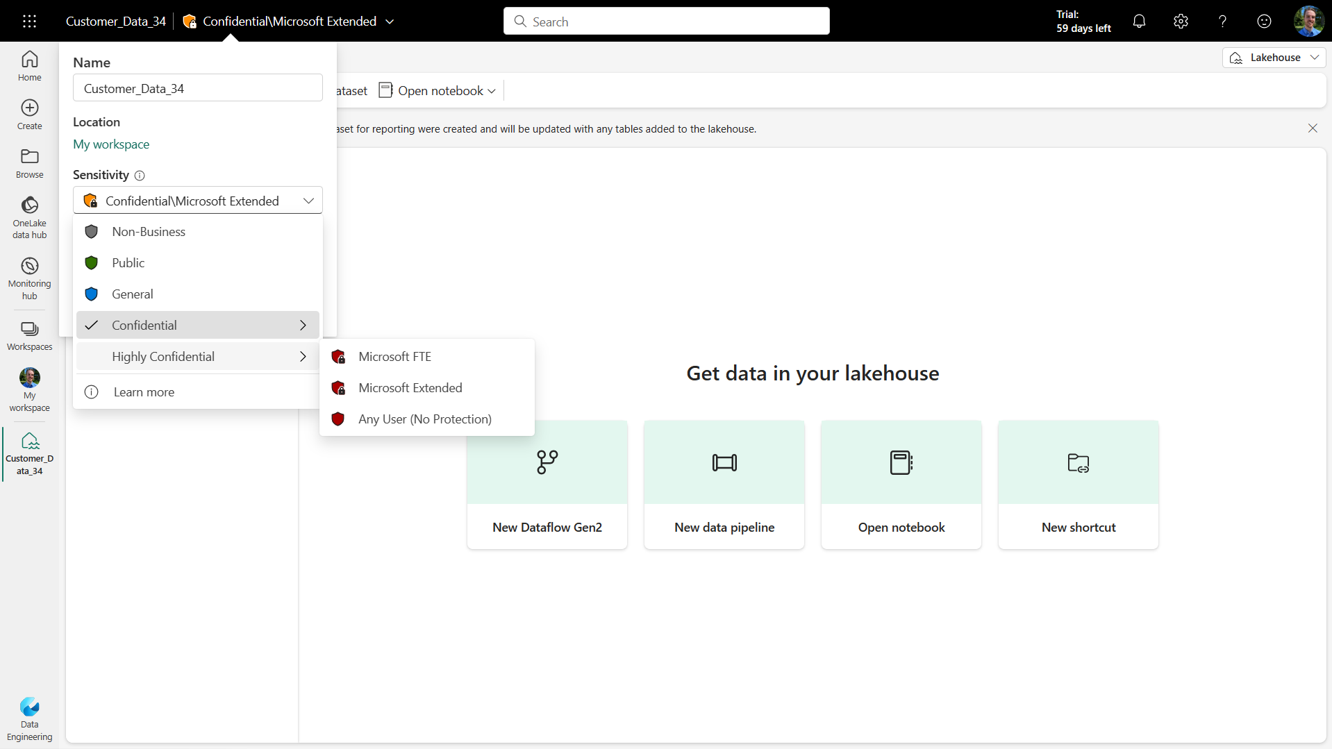
Information Protection labels
Sensitivity Labels guard sensitive content against unauthorized data access and leakage.
Travels with the data and enforced even when the data is exported to Office.
Gives insights into usage to security admin

Slide 77
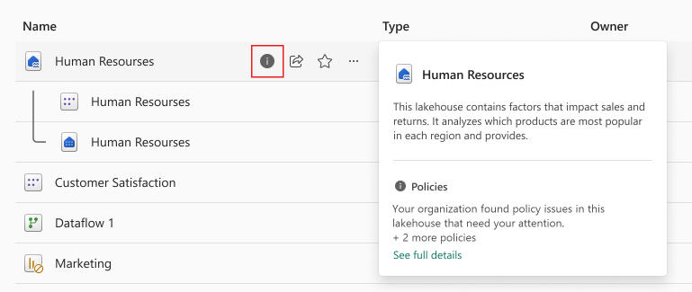
Data Loss Prevention policies (Preview)
Define Purview Data Loss Prevention (DLP) Policies
Automatically detect sensitive data proactively as it is loaded
Trigger immediate risk remediation such as alerts or restrict access.

Slide 78
Eventstream

Slide 79
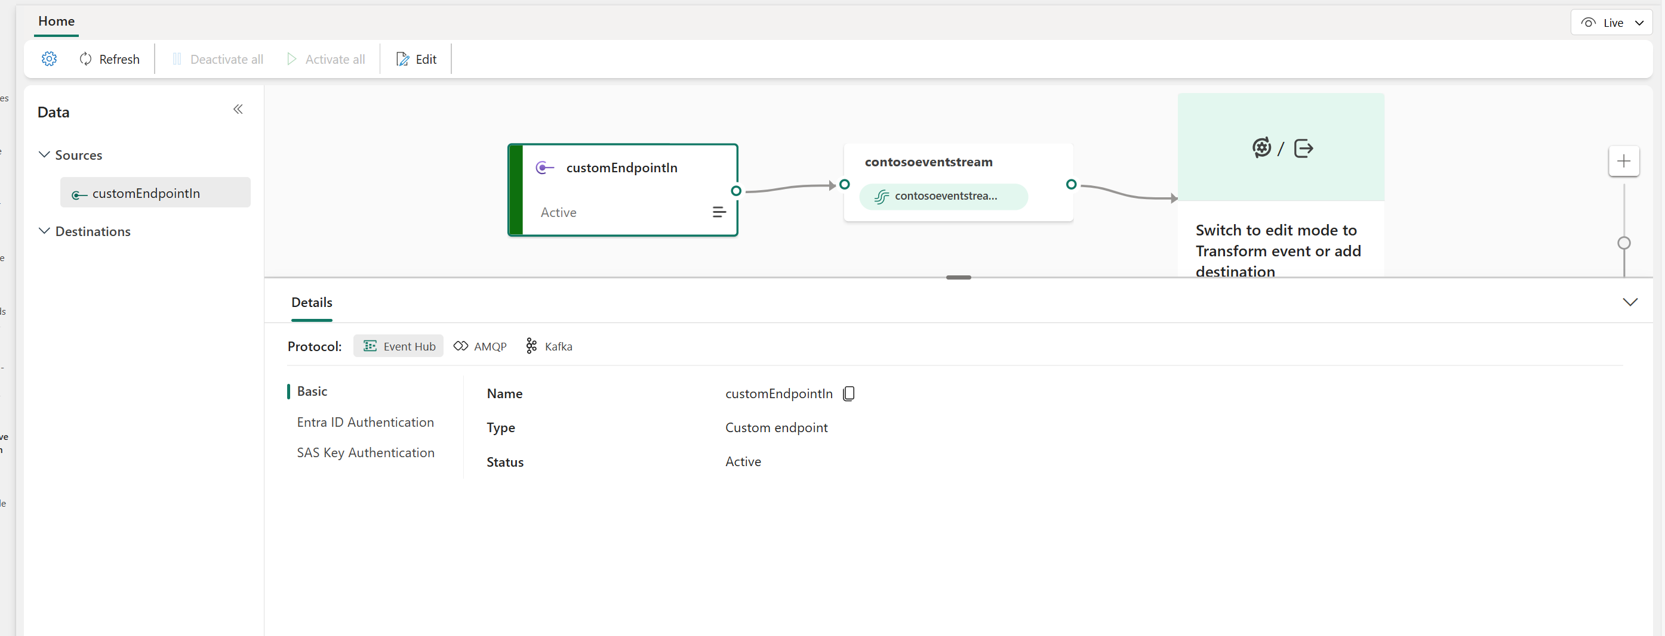
Custom Endpoint Security

Slide 80
Eventhouse

Slide 81
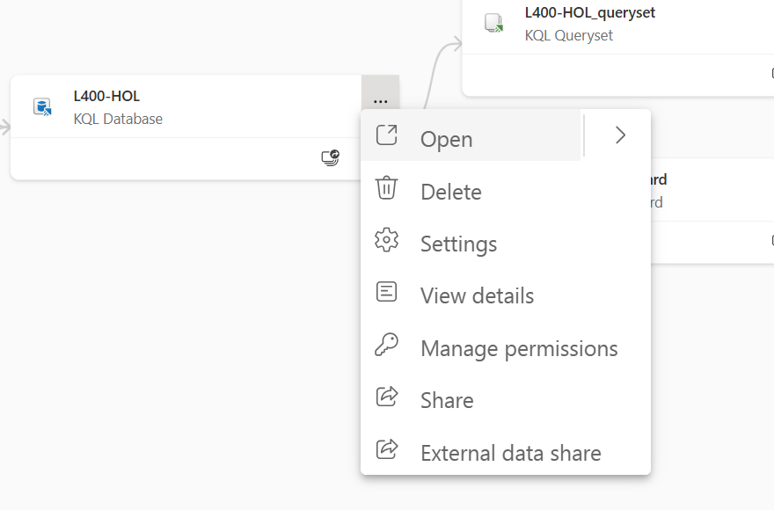
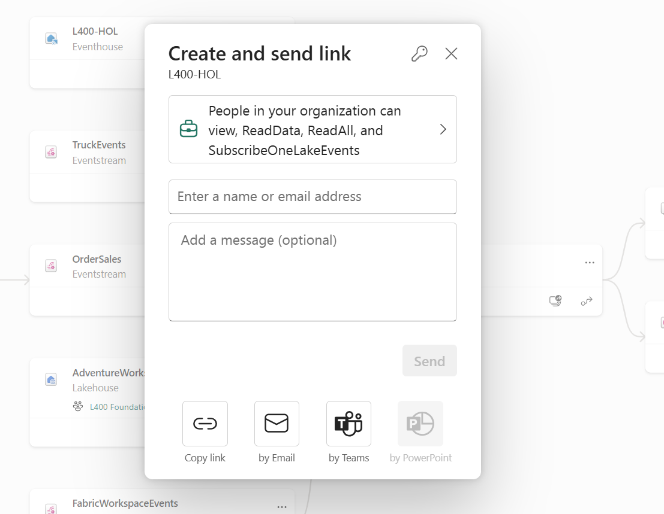
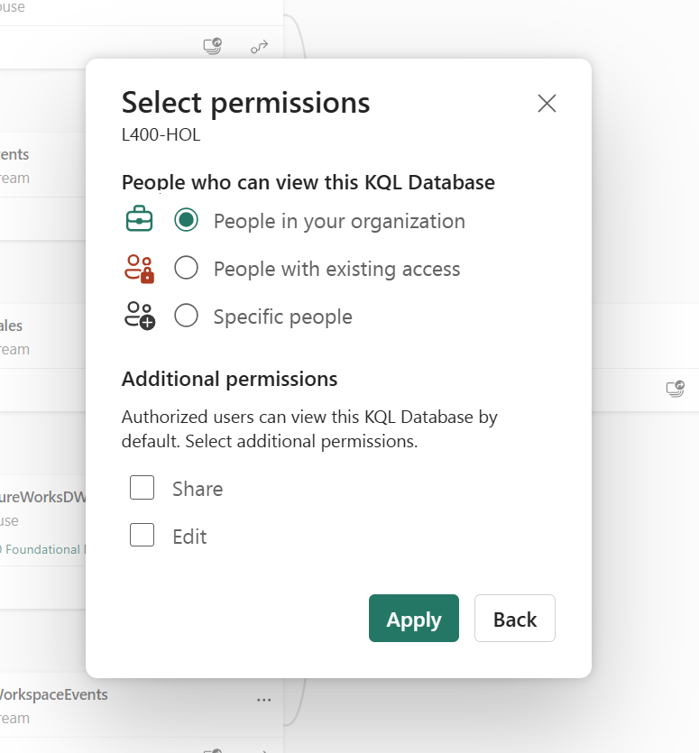
Share KQL Database

Slide 82
Networking

Slide 83
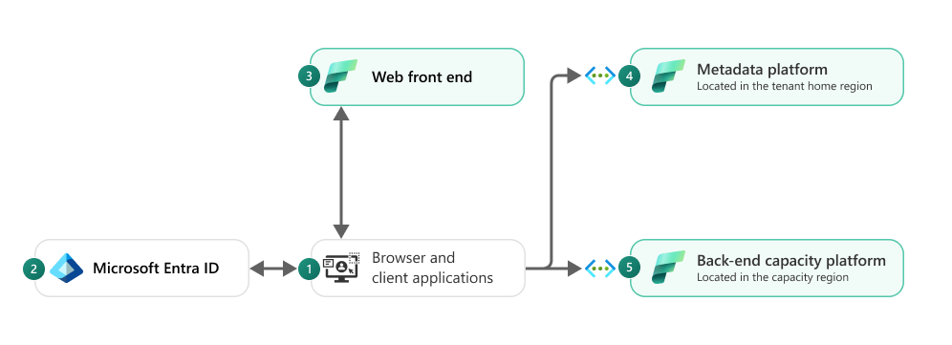
Microsoft Fabric Architecture
Fabrics is built as a SaaS product
Users connect to “Front End Services” and we are using “Entra ID” to authenticate and trust all requests.
All the clusters are protected behind “back-end services” and v-nets.
Traffic between experiences is going over MS backend network
Traffic to Fabric will be using at least TLS 1.2
Data in transit
Data in transit between Microsoft services is always encrypted with at least TLS 1.2. Fabric negotiates to TLS 1.3 whenever possible. Traffic between Microsoft services always routes over the Microsoft global network.
Notes:
Fabric is a SaaS Service.
Users connect only to “Front End Services” and we are using “Entra ID” to authenticate and trust all requests.
All the clusters are protected behind “back-end services”.

Slide 84
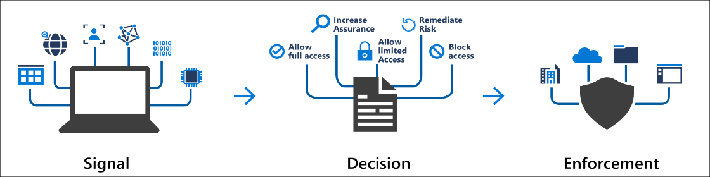




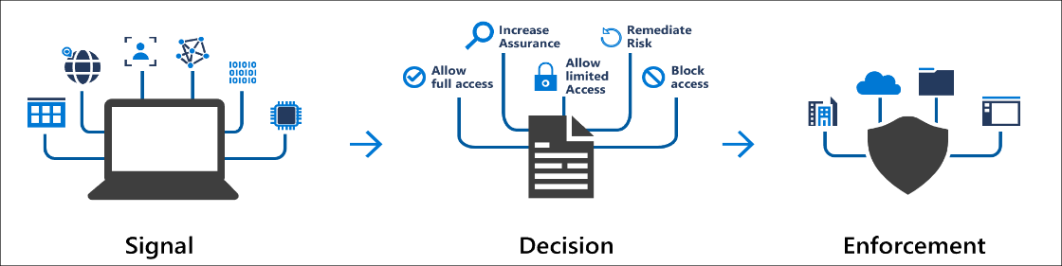
Conditional Access Policies
Common Decisions – Block, Grant, Require MFA
Users and Groups
Network Location
Entra Conditional Access Policies
Inbound
Applications
OneLake
Microsoft Fabric
Devices
Notes:
Microsoft Entra Conditional Access brings signals together, to make decisions, and enforce organizational policies.
Common Signals – Users, Devices and Locations
Common Decisions – Block, Grant, Require MFA
Conditional Access policies at their simplest are if-then statements; if a user wants to access a resource, then they must complete an action. For example: If a user wants to access an application or service like Microsoft 365, then they must perform multifactor authentication to gain access.

Slide 85
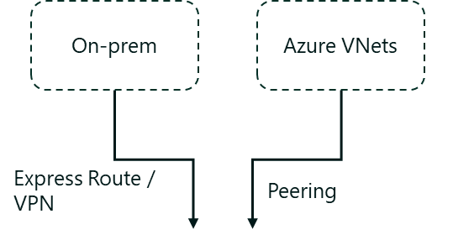
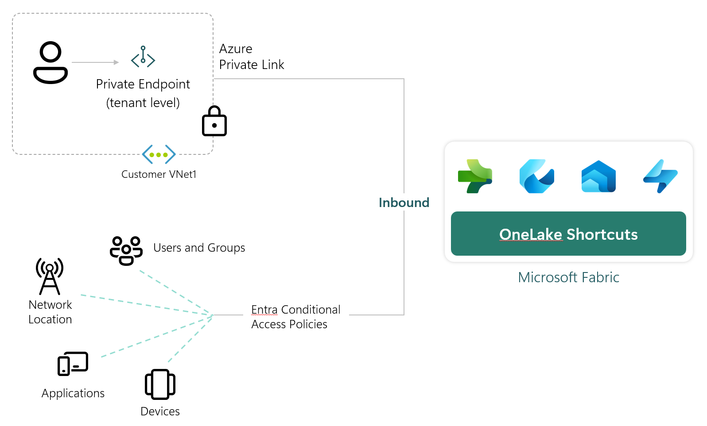
Tenant level Private Link for Fabric
Perimeter Network Security for your tenant
What it means:
1
Fabric is disconnected from the public internet
2
Every users needs to connect to the private network to get access on every device
3
No longer able to load resources locally (slower reports)
4
Increases ExpressRoute bandwidth and added costs for Private Links
5
Several product limitations (like on-prem data gateway)

Slide 86


Workspace level Private Link for Fabric
Perimeter Network Security for your workspace
On-prem
Azure VNets
Fabric Tenant
ExpressRoute / VPN
Peering
Workspace A
Workspace B
Azure Private Link
Lakehouse
Warehouse
Notebook
Private Data Access
Semantic Model
Report
Entra Conditional Access Policies
Private Endpoint
(Workspace Level)
(Tenant Level)
OneLake
Spark Job Definition
Pipeline
KQL Database
Customer VNet1
Disabled
Enabled (with Entra Conditional Access Policies)
Public Access
Selected workspaces can be protected using Private Links and closed from public internet.
Create a secure connection between public and private workspaces using private data access.
Public workspaces are secured through Entra policies for example to use Power BI.
Limitations of tenant wide PL don’t apply !!!

Slide 87
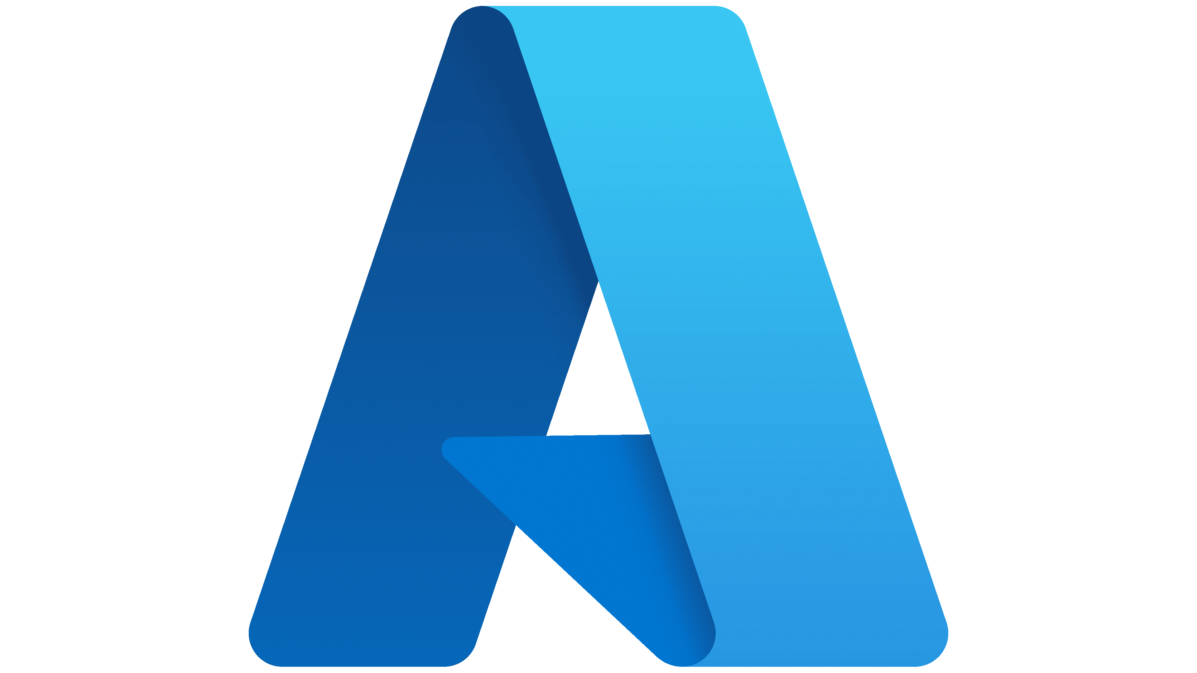











Getting data into Fabric
How to connect/load data in the private network from Fabric
Inbound
Outbound
OneLake Shortcuts
Azure PaaS
Shortcut to ADLS Gen2
Fabric Pipelines (COPY)
Fabric Spark
Amazon S3
Azure Data
Factory
Fabric Eventstreams
Fabric Pipelines (COPY)
Dataflows Gen2
GCS
OneLake
Azure
Databricks
COPY INTO DW
On-prem
S3 compatible
Azure Synapse Analytics (Spark)
On-Prem Data Gateway
VNet Data Gateway
Managed private endpoints
Trusted Workspace Access
On-Prem Data Gateway
All F SKUs
All F SKUs

Slide 88



Getting data into Real-Time Intelligence
How to connect/load data from VNET/On-Premise
vNET
Workspace
EventHub
Writes data to the embedded EventHub with “private link bypass!
Managed private endpoint
vNET
Workspace
Custom App
Writes data to the embedded EventHub with “private link bypass!

Slide 89
Visualization

Slide 90
Real-Time Dashboard
Dashboard
1…n
Page
1…n
Tile
Operations
Operations
Operations
Create
Edit
Copy link
Manage Permissions
Duplicate
Delete
Forget
Export to File
Replace with File
Share
Create
Edit
Add tile
Add text
Data source(s)
Auto refresh
Parameters
Rename
Duplicate
Delete
Move
Create
Edit
Rename
Duplicate
Delete
Move
Notes:
ADX Dashboard is built on 3 fundamental objects:
Dashboard: This is the over-arching container that holds all the pages and charts inside each page.
Page: This is the next level aggregation of charts enabling you to logically groups your charts by topics, subjects, datasets, or any aspect of your interest.
Tile: Each tile is a chart that represents the visualization of the underlying dataset.
Each object provides different set of operations to edit, share, manage the collections of charts and dashboards.

Slide 91
Real-Time Dashboard Sharing
Pass-through identity:
Default setting
User is able to view the data in the tiles if the have access to the underlying data source
Dashboard editor identity:
User can use the Dashboard`s editor identity & their permissions to access the underlying data source
If more than 1 editor, each needs to setup their own datasource.
Notes:
There are two types of permissions:
Fabric permissions: These permissions control the ability to view or edit a real-time dashboard when it's shared.
Data source permissions: These permissions control access to the underlying data used by a real-time dashboard.
When you share a real-time dashboard, you can specify if the user can view, edit, or share. These permissions are for the real-time dashboard itself and not the underlying data.

Slide 93
Use drillthroughs as dashboard parameters
Notes:
Drillthroughs allow you to select a value in a visual and use it to filter the visuals in a target page within the same dashboard. When the target page opens, the value is preselected in the relevant filters. The visuals on the page, such as line or scatter charts, are filtered to only show related data. This feature is useful for creating dashboards with drillthroughs from a summary page to a details page.

Slide 94
Use drillthroughs as dashboard parameters
Notes:
Once drillthroughs are defined, you can use them to interact with your data. To do so, in visuals or tables where you've defined a drillthrough, right-click on a data point, and then select Drill through to > destination page. The values from the data point are used as the parameters to filter the visuals on the target page.

Slide 95
Modeling for Power BI

Slide 96
Power BI Modes
Mode | Description | When to Use
DirectQuery | Queries the Eventhouse database live at query time. | Real-Time freshness is critical. Data size too large to fit in memory.
Import | Imports a static snapshot of the data into Power BI memory. | When query latency from Eventhouse is high, or high-performance dashboards needed.
Dual | Supports both import and DirectQuery dynamically. | Best of both worlds; for filtering and small lookups.
DirectLake | For lakehouse scenarios, not typical for KQL sources. | Only when sourcing via OneLake or Delta tables.

Slide 97
Storage Mode Strategy
Real-world guidance for fabric Real-Time Intelligence to Power BI modeling:
Table Type | Recommended Storage Mode | Reason
Fact Table (Events, Logs) | DirectQuery | Real-Time freshness; too big for import.
Small Dimensions (Lookup Tables) | Dual | Faster slicer/filtering; caches locally.
Large Dimensions | DirectQuery | If size > 1M rows and freshness needed.

Slide 98
Best practices for using Power BI with Eventhouse
Travel light - Bring only the data that you need for your reports to Power BI. For deep interactive analysis, use the Eventhouse Web UI that is optimized for ad-hoc exploration with the KQL.
Composite model - Use composite model to combine aggregated data for top-level dashboards with filtered operational raw data. You can clearly define when to use raw data and when to use an aggregated view.
Parallelism - improve the performance of dashboard rendering by increasing the parallelism of the end-to-end flow as follows:
Increase the number of concurrent connections in DirectQuery in Power BI.
Effective slicers – Use sync slicers to prevent reports from loading data before you're ready. After you structure the data set, place all visuals, and mark all the slicers, you can select the sync slicer to load only the data needed.
Use filters - Use as many Power BI filters to focus the Eventhouse search on the relevant data shards.
Efficient visuals – Select the most performant visuals for your data.
Notes:
Ref: https://docs.microsoft.com/azure/data-explorer/power-bi-best-practices

Slide 99
Handling DateTime Columns
Datetime modeling is non-trivial with KQL sources​​​:
Always treat DateTime columns as UTC.
Create a Calendar Table to filter by dates.
Use datetime_utc_to_local() only carefully (performance penalty if used extensively​).
Use relative time slicers in Power BI for "Last N hours/minutes" analysis​.
Example of generating a DateTime table (M Query):
let
StartDate = DateTime.From(Date.AddDays(DateTime.LocalNow(), -30)),TimeSeries = List.DateTimes(StartDate, 43200, #duration(0,0,1,0)),
#"Converted to Table" = Table.FromList(TimeSeries, Splitter.SplitByNothing(), {"Timestamp"})
in
#"Converted to Table"

Slide 100
Query Pushdown and Native Query
When using the Azure Eventhouse (Kusto) connector:
Native Query folding is supported: KQL runs server-side.
Avoid heavy Power Query (M) transformations post-load — push filtering and aggregation into KQL as much as possible.
Best practice: Model complex transformations as Kusto Functions inside Fabric and reference them from Power BI.

Slide 101
Monitoring Power BI Query Performance
In large Real-Time Intelligence solutions:
Use Performance Analyzer in Power BI Desktop.
Watch for slow DirectQuery requests.
Profile KQL query execution in Eventhouse side (.show queries).
Typical signs of bad modeling:
High row retrieval counts
Slow slicer/filter performance
Repeated queries without result reuse

Slide 102
Common Modeling Pitfalls
No star schema: Flat wide tables slow down slicers.
DirectQuery everything: Even for small dimension tables — causes unnecessary latency.
Local time conversions in visuals: Slows queries massively.
Missing relationships: Forces Power BI to do expensive cartesian joins.
Overuse of calculated columns: Instead, compute fields at the source using KQL.

Slide 103
Considerations
Schema Design:
Use narrow-wide schema pattern for flexible slicing
Normalize values to support slicers (regions, states, event types)
What a Narrow-wide Schema Is and When To Use It:
This is a deliberate design pattern in data modeling for real-time analytics
Narrow Schema: Each row captures a single measurement or attribute, and multiple rows may represent the same entity at a single timestamp. Common columns include entity_id, timestamp, metric_name, and value
Wide Schema: Each row represents one entity at one point in time, and each metric is stored as a separate column
Use a hybrid approach:
Store operational telemetry in narrow schema for dashboarding and alerting
Maintain a wide materialized view for performant multi-metric aggregation when needed, especially for pages that compare multiple metrics at once

Slide 104
Security

Slide 105
Security layers in Microsoft Fabric
Network security
Workspace & item security
Data security
Your data in Fabric
…
Regulations & Certification
Data Encryption
High Availability & Disaster Recovery
E2E Auditability with Microsoft Purview
Information protection labels with Microsoft Purview
Additional advanced tools in Microsoft Purview
3rd party and in-house governance & security solutions
Notes:
Speaker: Adi Regev
Microsoft Fabric’s SaaS architecture and industry-leading security tools can help you simplify and accelerate security configuration while ensuring your data is protected at every step of its journey.
Fabric comes with always-on, default security and a wide set of tools so you can more easily manage the security needed for every scenario. Data users and security admins get specific tools designed for them so everyone can help ensure only the right people have access to the right data.
Microsoft Fabric is also certified with a huge range of industry compliance standards and provides full control over your data’s location so you can always remain compliant. All of this functionality comes in a cloud-based, pre-integrated and optimized SaaS environment—removing much of the cost and responsibility for maintaining your security.
Data security – RLS/CLS on semantic model, kustoDB, SQL DB, Fabric DW….
Onesecuirty – control roles to define access to data (for LH, other WLs to follow)
********************************************************************************************************
These are the security layers in Fabric:
Uppermost layer is the network security, to ensure there is no data leakage. Inbound network security to protect network traffic coming into Fabric (with private links, and Conditional access using Entra ID) and it is about outbound security to ensure secured connection with external data sources with Managed private endpoints and managed virtual networks, ip allowed list and more.
Next layer is for the workspace and item owners to manage access to their data and to define rls and cls as needed.
The next layer is data security, that it brings the power of Purview security together with Fabric to help you better protect you data.

Slide 106
Multiple layers of security and access control
Platform level access. Authentication through Entra ID. Inbound through Private Link or Conditional access
Microsoft Fabric (SaaS tenant)
Domain
Domain specific configuration. by domain admins
Workspace
Item
Item
Item
Item
Workspace level access. Boundary for managing items. E.g. admin, contributor and viewers.
Compute security. e.g. Warehouse access through GRANT/DENY or Semantic Models & Warehouse RLS \ OLS.
OneLake
Files
Shortcuts
Tables
Tables
Item level access. e.g. read all only via OneLake or read access to only subset of data. More granular roles for files and folders.

Slide 107
Information Protection labels
Sensitivity Labels guard sensitive content against unauthorized data access and leakage.
Travels with the data and enforced even when the data is exported to Office.
Gives insights into usage to security admin

Slide 108
Data Loss Prevention policies (Preview)
Define Purview Data Loss Prevention (DLP) Policies
Automatically detect sensitive data proactively as it is loaded
Trigger immediate risk remediation such as alerts or restrict access.

Slide 109
Eventstream

Slide 110
Custom Endpoint Security

Slide 111
Eventhouse

Slide 112
Share KQL Database

Slide 113
Networking

Slide 114
Microsoft Fabric Architecture
Fabrics is built as a SaaS product
Users connect to “Front End Services” and we are using “Entra ID” to authenticate and trust all requests.
All the clusters are protected behind “back-end services” and v-nets.
Traffic between experiences is going over MS backend network
Traffic to Fabric will be using at least TLS 1.2
Data in transit
Data in transit between Microsoft services is always encrypted with at least TLS 1.2. Fabric negotiates to TLS 1.3 whenever possible. Traffic between Microsoft services always routes over the Microsoft global network.
Notes:
Fabric is a SaaS Service.
Users connect only to “Front End Services” and we are using “Entra ID” to authenticate and trust all requests.
All the clusters are protected behind “back-end services”.

Slide 115
Conditional Access Policies
Common Decisions – Block, Grant, Require MFA
Users and Groups
Network Location
Entra Conditional Access Policies
Inbound
Applications
OneLake
Microsoft Fabric
Devices
Notes:
Microsoft Entra Conditional Access brings signals together, to make decisions, and enforce organizational policies.
Common Signals – Users, Devices and Locations
Common Decisions – Block, Grant, Require MFA
Conditional Access policies at their simplest are if-then statements; if a user wants to access a resource, then they must complete an action. For example: If a user wants to access an application or service like Microsoft 365, then they must perform multifactor authentication to gain access.

Slide 116
Tenant level Private Link for Fabric
Perimeter Network Security for your tenant
What it means:
1
Fabric is disconnected from the public internet
2
Every users needs to connect to the private network to get access on every device
3
No longer able to load resources locally (slower reports)
4
Increases ExpressRoute bandwidth and added costs for Private Links
5
Several product limitations (like on-prem data gateway)

Slide 117
Workspace level Private Link for Fabric
Perimeter Network Security for your workspace
On-prem
Azure VNets
Fabric Tenant
ExpressRoute / VPN
Peering
Workspace A
Workspace B
Azure Private Link
Lakehouse
Warehouse
Notebook
Private Data Access
Semantic Model
Report
Entra Conditional Access Policies
Private Endpoint
(Workspace Level)
(Tenant Level)
OneLake
Spark Job Definition
Pipeline
KQL Database
Customer VNet1
Disabled
Enabled (with Entra Conditional Access Policies)
Public Access
Selected workspaces can be protected using Private Links and closed from public internet.
Create a secure connection between public and private workspaces using private data access.
Public workspaces are secured through Entra policies for example to use Power BI.
Limitations of tenant wide PL don’t apply !!!

Slide 118
Getting data into Fabric
How to connect/load data in the private network from Fabric
Inbound
Outbound
OneLake Shortcuts
Azure PaaS
Shortcut to ADLS Gen2
Fabric Pipelines (COPY)
Fabric Spark
Amazon S3
Azure Data
Factory
Fabric Eventstreams
Fabric Pipelines (COPY)
Dataflows Gen2
GCS
OneLake
Azure
Databricks
COPY INTO DW
On-prem
S3 compatible
Azure Synapse Analytics (Spark)
On-Prem Data Gateway
VNet Data Gateway
Managed private endpoints
Trusted Workspace Access
On-Prem Data Gateway
All F SKUs
All F SKUs

Slide 119
Getting data into Real-Time Intelligence
How to connect/load data from VNET/On-Premise
vNET
Workspace
EventHub
Writes data to the embedded EventHub with “private link bypass!
Managed private endpoint
vNET
Workspace
Custom App
Writes data to the embedded EventHub with “private link bypass!

